Slide 1
Parallel Algorithms

Slide 2
Parallel Algorithms
Modern supercomputers employ several different modalities of operation to take advantage of parallelism
Three of these most common hardware architecture forms present in a supercomputer are
Single-Instruction Multiple Data (SIMD) parallelism,
shared memory parallelism,
and distributed memory parallelism.
Shared memory parallelism and distributed memory parallelism are subclasses of the Multiple Instruction Multiple Data (MIMD) class of Flynn’s computer architecture taxonomy.

Slide 3
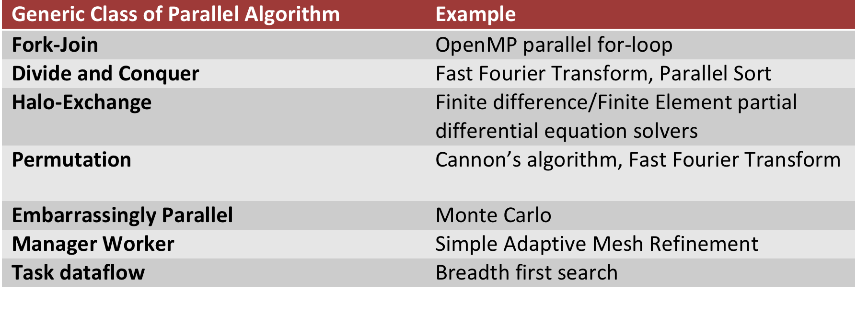
Classes of Parallel Algorithms
Among the many parallel algorithms used on modern supercomputers, several classes of parallel algorithms arise that share key characteristics and are driven by the underlying mechanism from which the parallelism is derived.

Slide 4
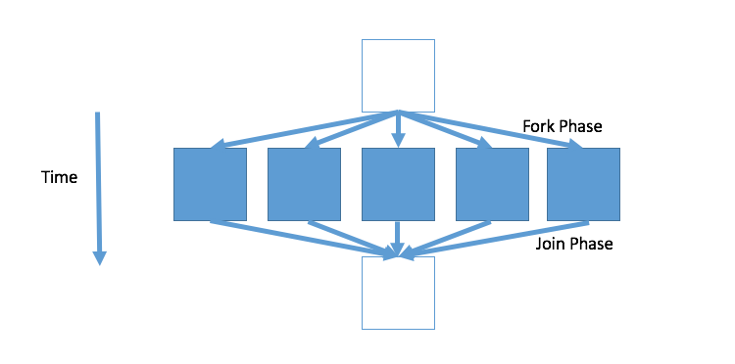
Fork-Join
The fork-join parallel design pattern is a key component of the OpenMP execution model
is frequently employed in programming models targeting shared memory parallelism
In regions of a sequential algorithm where work can proceed concurrently, a group of lightweight concurrent operators frequently called “threads” are created to perform that work
Once the work is completed, the results from each of these operators are accumulated during the “join” phase

Slide 5
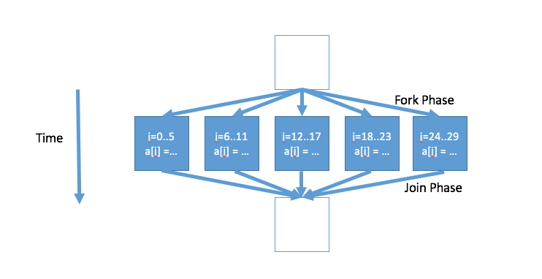
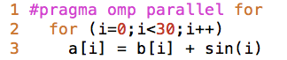
Fork-Join Example
A previously initialized array b is added to another expression to initialize array a. Because each work element in the for-loop (see line 3) is independent of every other element, the work in this loop can proceed concurrently. Consequently, a parallel for-loop construct is added in line 1.

Slide 6
Divide and Conquer
Algorithms denoted as “divide and conquer” break a problem into smaller sub-problems that share similar enough algorithmic properties to the original problem that they can in turn also be subdivided
Using recursion, the larger problem is broken down into small enough pieces that it can be easily solved with minimal computation.
Because the original problem has been broken down into several smaller computations that are independent of one another, there is a natural concurrency for exploiting parallel computation resources
Frequently, divide and conquer type algorithms are also naturally parallel algorithms because of this concurrency and, like fork-join type algorithms, can perform very well on shared memory architectures
On distributed memory architectures, however, network latency and load imbalance can complicate the direct application of divide and conquer type algorithms.

Slide 7
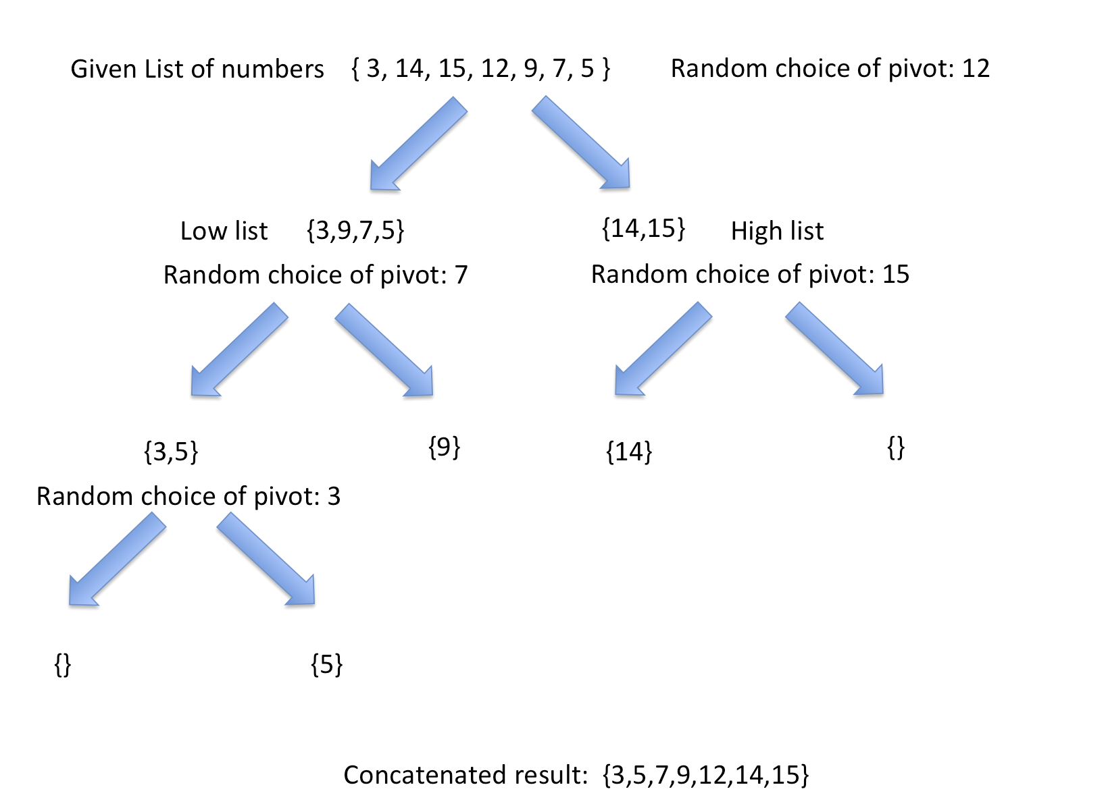
Divide and Conquer Example: Quicksort
One well studied example of a divide and conquer algorithm with natural concurrency is quicksort
As a sorting algorithm, it aims to sort a list of numbers in order of increasing value.
To start, a pivot point is selected: one element of the array of numbers is selected as the pivot

Slide 8
Divide and Conquer Example: Quicksort
Using this pivot, the rest of the list is divided into a list containing numbers smaller than the pivot and a list containing numbers larger than the pivot

Slide 9
Divide and Conquer Example: Quicksort
This process is then repeated recursively for each of the two lists

Slide 10
Divide and Conquer Example: Quicksort
Upon completion of recursion the resulting sorted child sub-problems are concatenated for the final result.

Slide 11
Divide and Conquer Example: Quicksort
The efficiency of the algorithm is significantly impacted by which element is chosen as the pivot point.
If the array has N data items, the worse case performance will be proportional to N²
for most cases the performance is much faster, proportional to N log N
Because the two branched lists in quicksort can be sorted independently, there is a natural concurrency of computation that can be used for parallelization

Slide 12
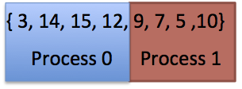
Distributed Quicksort
On a distributed memory architecture, exploiting this concurrency incurs a significant communication cost as sorted lists are passed from one process to another during recursion
A modification to the approach based on sampling can be made to improve this:
An array of numbers to be sorted is distributed equally among P processes. Thus if the array size is N then each process will have N/P local elements.

Slide 13
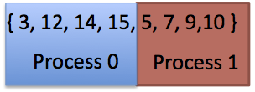
Distributed Quicksort
Each process runs sequential quicksort on its local data

Slide 14
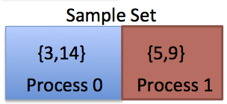
Distributed Quicksort
The resulting sorted arrays are sampled at intervals determined by the global array size, N, and the number of processes, P. Samples are taken at every N/P² location starting at 0, i.e.: array element indices 0, N/P², 2N/P², …, (P-1) N/P² form the sample array from each local data.

Slide 15
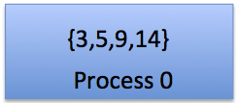
Distributed Quicksort
The resulting samples are gathered to a root process and sorted sequentially with quicksort.

Slide 16
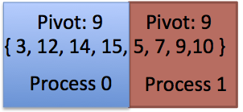
Distributed Quicksort
Regularly sampled P-1 pivot values computed from the sample set are broadcast to the other processes. Thus N/P², 2N/P², …, indices form the sample P-1 pivot points.

Slide 17
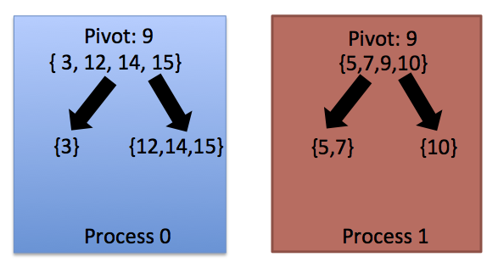
Distributed Quicksort
Each process divides its sorted segment of the array into P segments using the broadcasted P-1 pivot values.

Slide 18
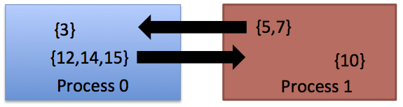
Distributed Quicksort
Each process performs an all-to-all operation on the P segments. Thus the ith process keeps the ith segment and sends the jth segment to the jth process.

Slide 19
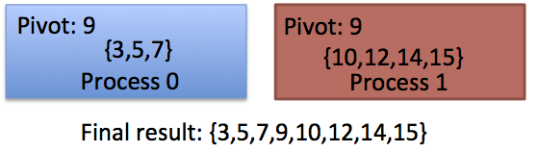
Distributed Quicksort
The arriving segments are merged into a single list.

Slide 20
Manager Worker
Manager worker incorporate two different workflows in their execution: one intended for execution by just one process called the manager process and another intended for execution by several other processes called worker processes.
This approach has also historically been called “Master-Slave”
Applications that are dynamic in nature frequently use this type of parallel design algorithm so that the manager process can coordinate and issue task actions to worker processes in response to changes in a simulation outcome.

Slide 21
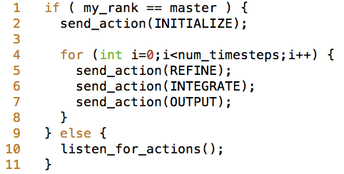
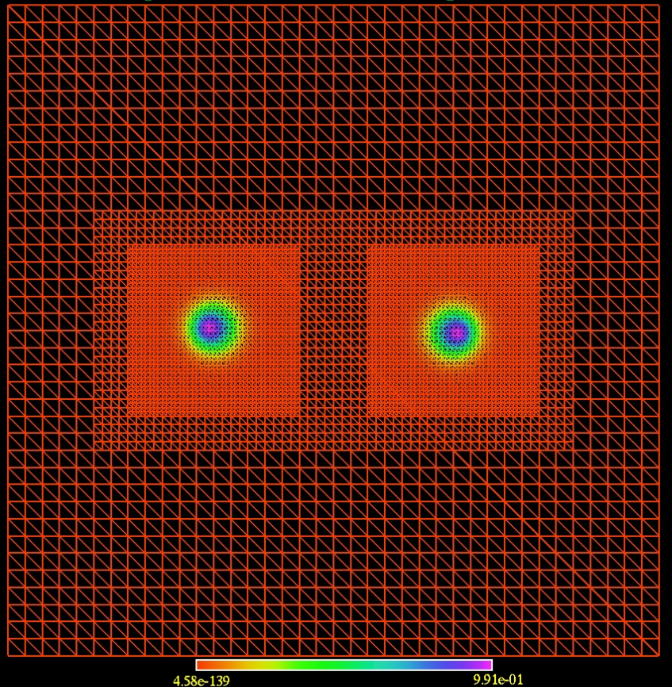
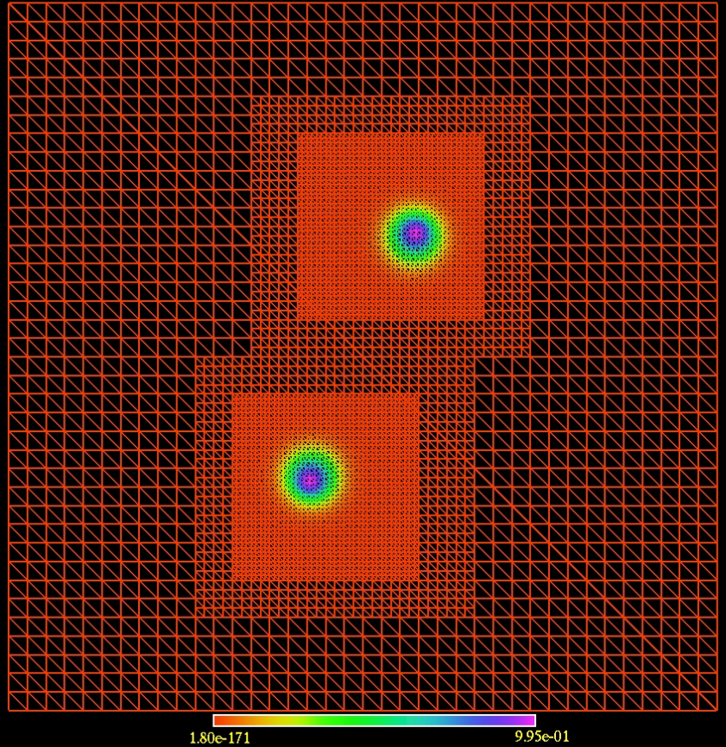
Manager Worker Example
Manager-worker example code from an adaptive mesh refinement code. The manager process (called “master” here) directs the refinement characteristics and sends actions to the worker processes.

Slide 22
Embarrassingly Parallel
The term “embarrassingly parallel” is a common phrase in scientific computing that is both widely used and poorly defined
It suggests lots of parallelism with essentially no inter-task communication or coordination as well as a highly partitionable workload with minimal overhead.
In general, embarrassingly parallel algorithms are a subclass of manager-worker algorithms.
They are called embarrassingly parallel because the available concurrency is trivially extracted from the workflow.
While these algorithms may require some minimal coordination and inter-task communication, they are still generally referred to as embarrassingly parallel.

Slide 23
Embarrassingly Parallel Example
Monte Carlo simulations generally fall into the category of embarrassingly parallel.
Monte Carlo methods are statistical approaches for studying systems with:
a large number of coupled degrees of freedom,
modeling phenomena with significant uncertainty in the inputs,
and solving partial differential equations with more than 4 dimensions.
Computing the value of pi is a simple example

Slide 24
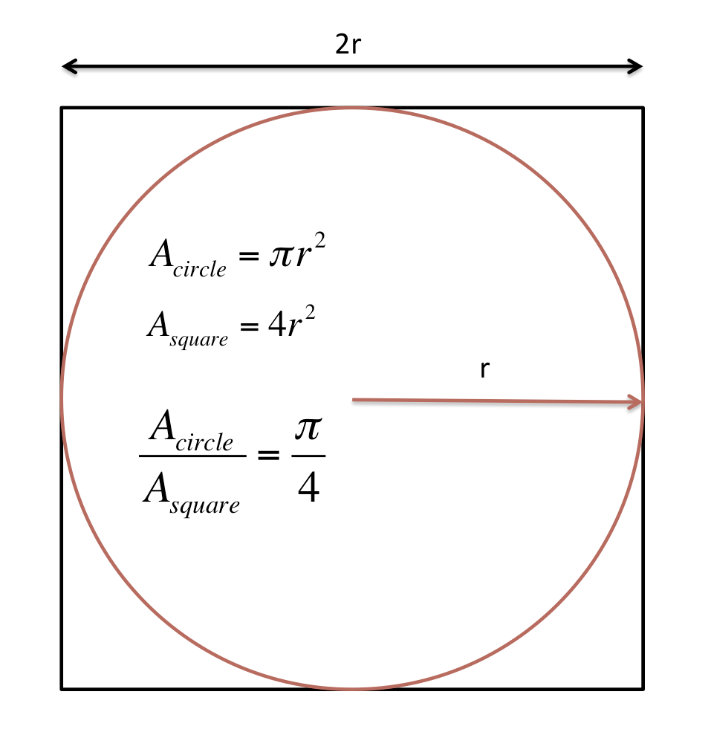
Embarrassingly Parallel Example: Pi
Define a square domain and inscribe a circle inside that domain
Randomly generate the coordinates of points lying inside the square domain; count the points that also lie in the circle.
pi/4 is the ratio of the number of points that lie in the circle to the total number of random points generated.

Slide 25
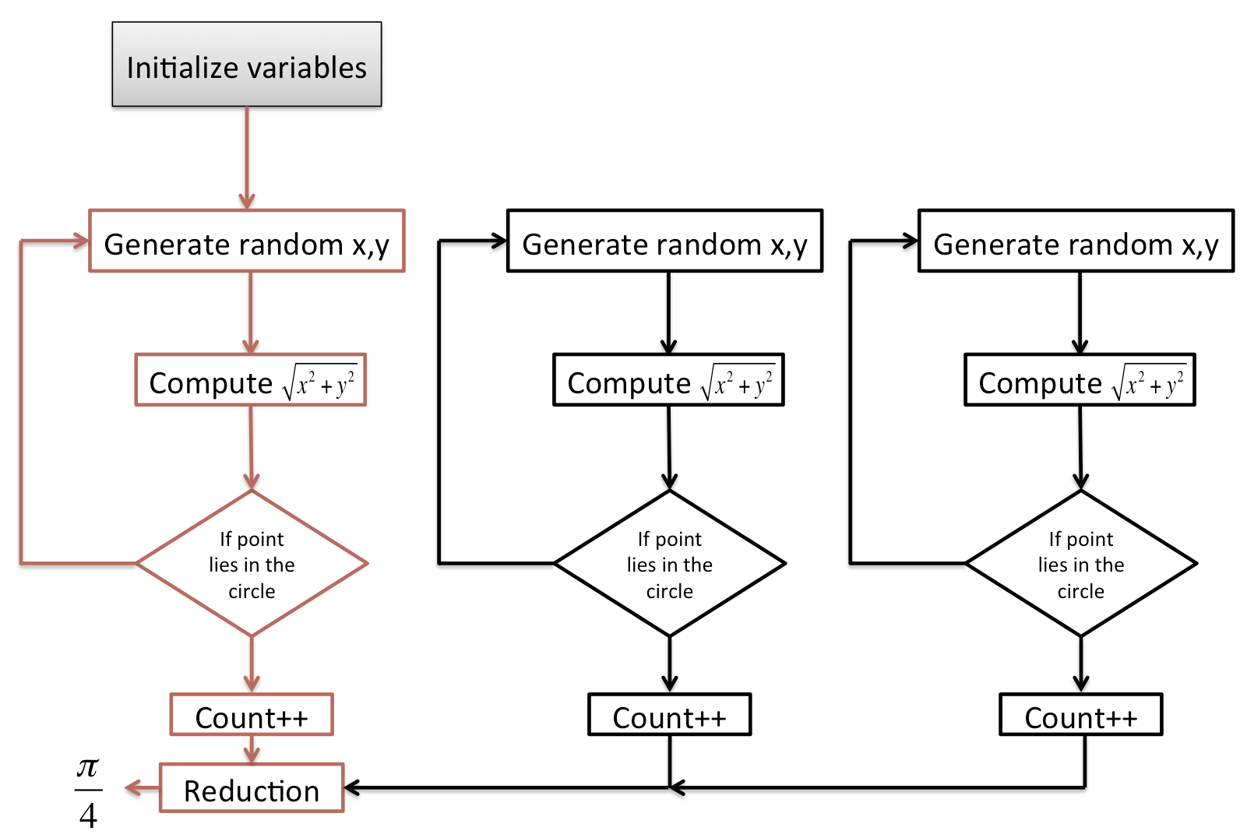
Embarrassingly Parallel Example: Pi

Slide 26
Halo-exchange
Many parallel algorithms fall into a parallel problem class where every parallel task is executing the same algorithm on different data without any manager algorithm present.
This is sometimes referred to as the data parallel model.
Data parallelism is frequently used in applications that are static in nature because a computational task can be mapped to particular subset of data throughout the life of the simulation.
Some information in each data subset mapped to the parallel task has to be exchanged and synchronized in order for the application algorithm to function properly.
This exchange of inter-task information is called halo-exchange.

Slide 27
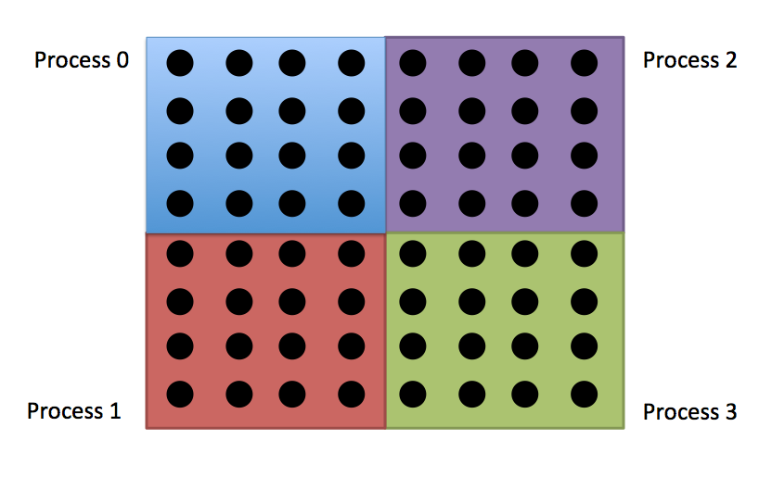
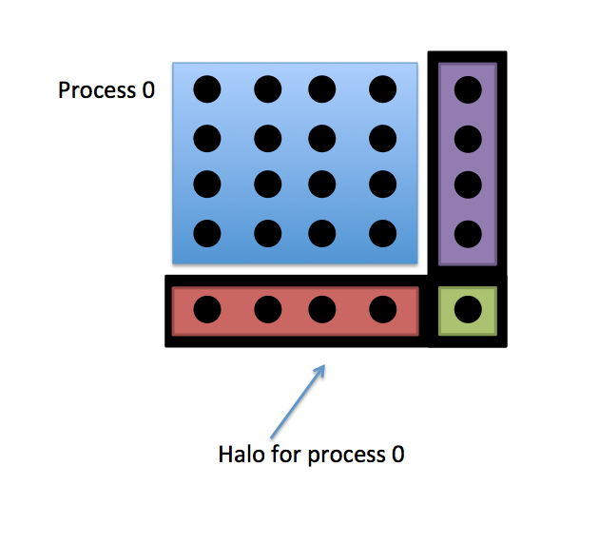
Halo Exchange
As the name implies, a halo is a region exterior to the data subset mapped to a parallel task.
It acts as an artificial boundary to that data subset and contains information that originates from the data subsets of neighboring parallel tasks.

Slide 28
Halo Exchange Example – The Advection Equation
The study of wavelike phenomena is ubiquitous on supercomputing systems and is frequently modeled using a partial differential equation, or an expression involving derivatives taken against different independent variables.
One of the simplest ways to solve these wavelike partial differential equations on a supercomputer is through the use of finite differencing and halo exchange.
Finite differencing involves replacing the derivative expressions in the partial differential equation with approximations originating from estimating the slope between neighboring points on a uniform grid.
As an example of this parallel algorithm, consider the advection equation :

Slide 29
The Advection Equation
This advection equation transports a scalar field f(x,t) towards increasing x value with speed v.
The analytic solution to this partial differential equation is
Where F(x) is an arbitrary function describing the initial condition of the system.

Slide 30
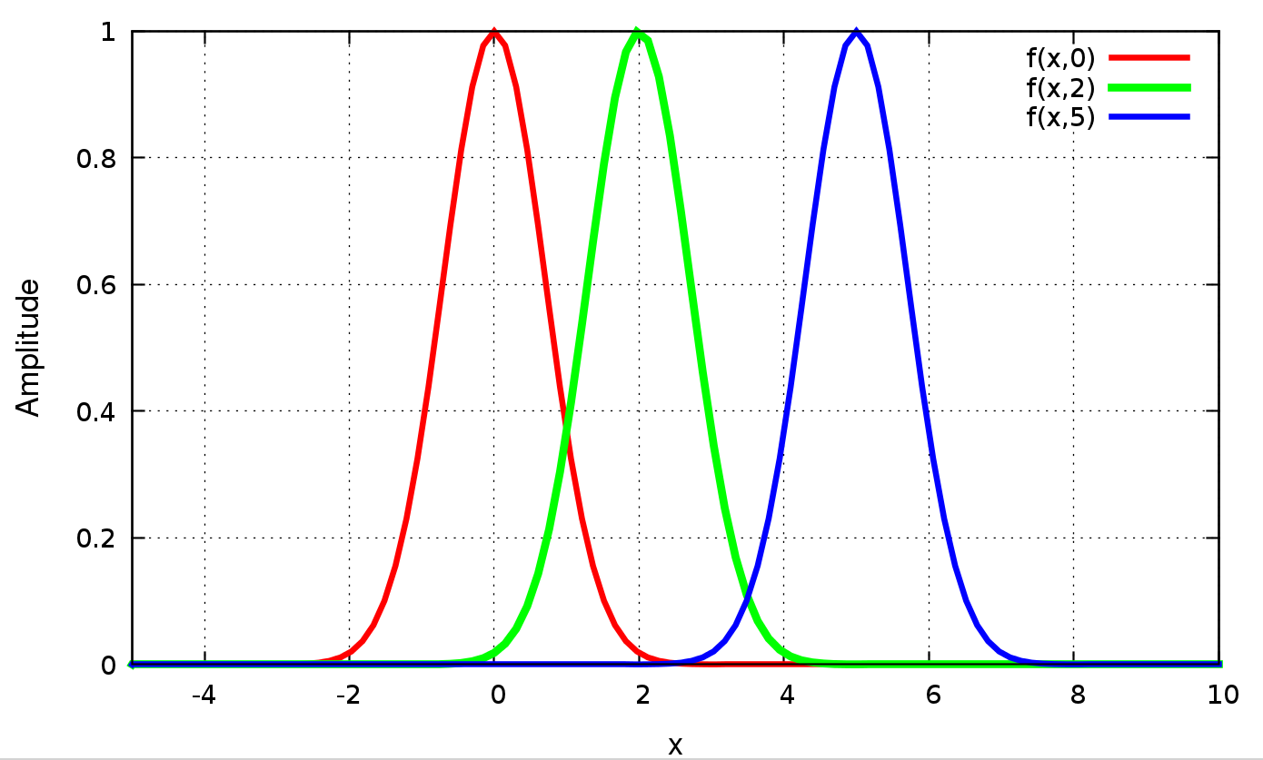
The Advection Equation
Suppose the initial condition was:
The the analytic solution to the advection equation would be:

Slide 31
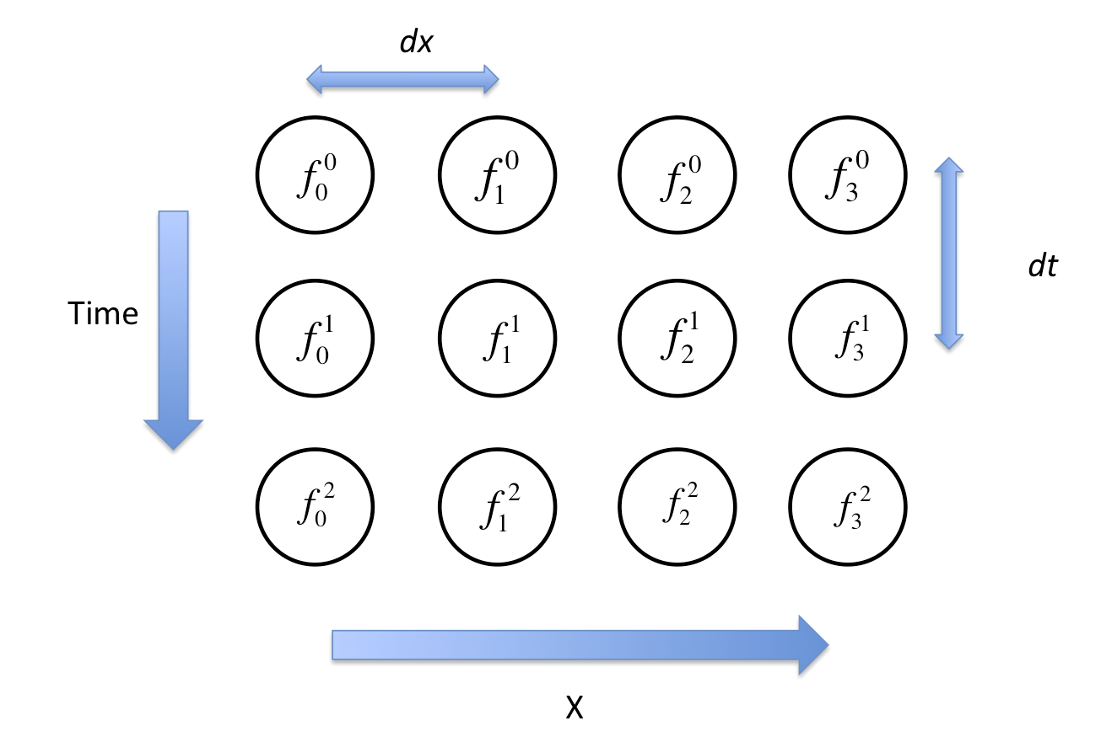
Halo Exchange – the advection equation
The left and right hand partial derivatives in the advection equation are replaced with finite difference approximations to those derivatives
.
The field f(x,t) has been discretized to a uniform mesh where the x points are separated by distance dx and the time points are separated by time dt with the subscript to f indicating the spatial location in that mesh and the superscript to f indicating the temporal location in that mesh.

Slide 32
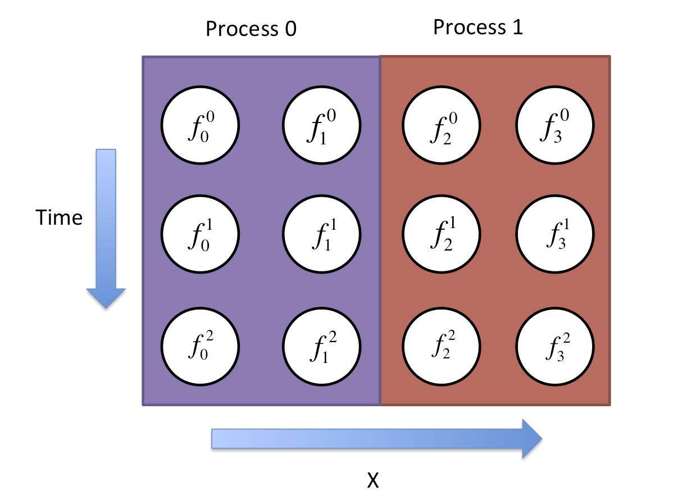
Halo Exchange – the advection equation
Algebraic manipulation of the finite difference discretization enables all future times values to be found iteratively:
In order to compute the right hand side of this expression in parallel, the discretized mesh is partitioned across several processes:

Slide 33
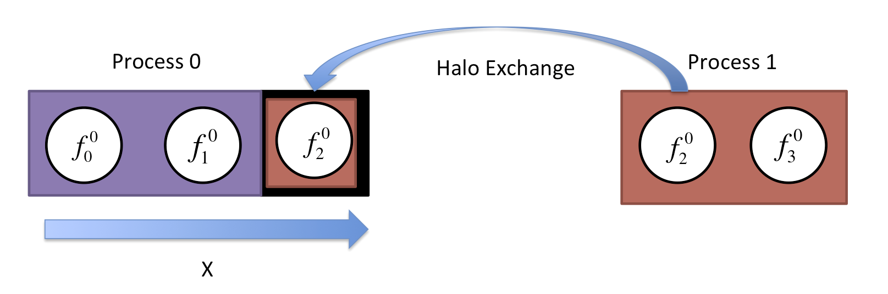
Halo Exchange – the advection equation
To evaluate the right hand side of
for process 0, some information is needed from process 1. This information is provided through halo exchange:
(9.6)

Slide 34
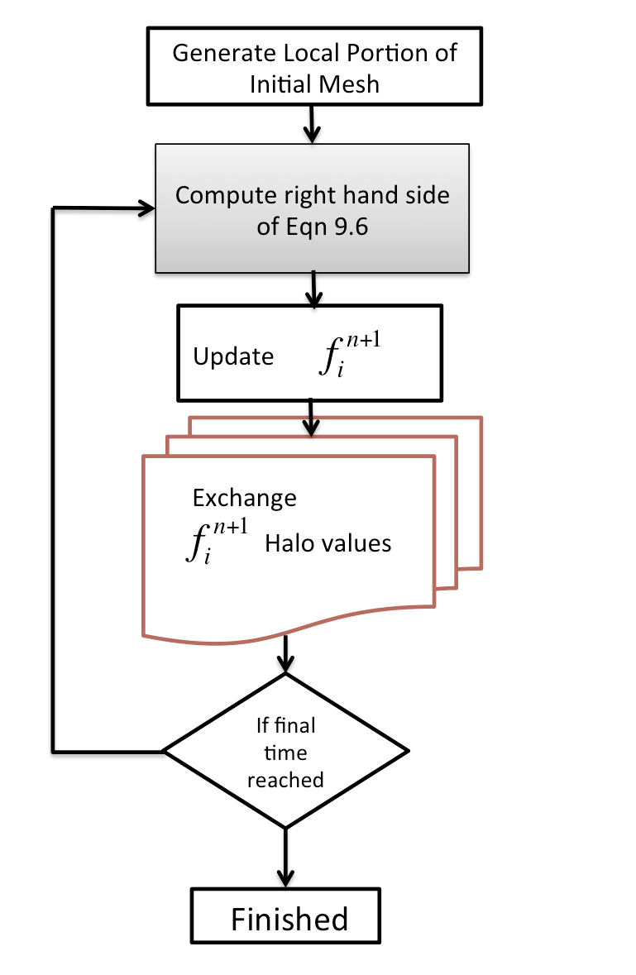
Halo Exchange – the advection equation

Slide 35
Halo Exchange – Sparse Matrix Vector Multiplication
Parallel algorithms designed around halo exchange frequently show up not just in mesh based solvers but also in sparse linear algebra operations such as sparse matrix vector multiplication used in the HPCG benchmark.
For a matrix of size N x N and vector of size N, matrix-vector multiplication is given by
where A_{ij} is the (i,j)-th element of the matrix and b_{j} is the j-th element of the vector.

Slide 36
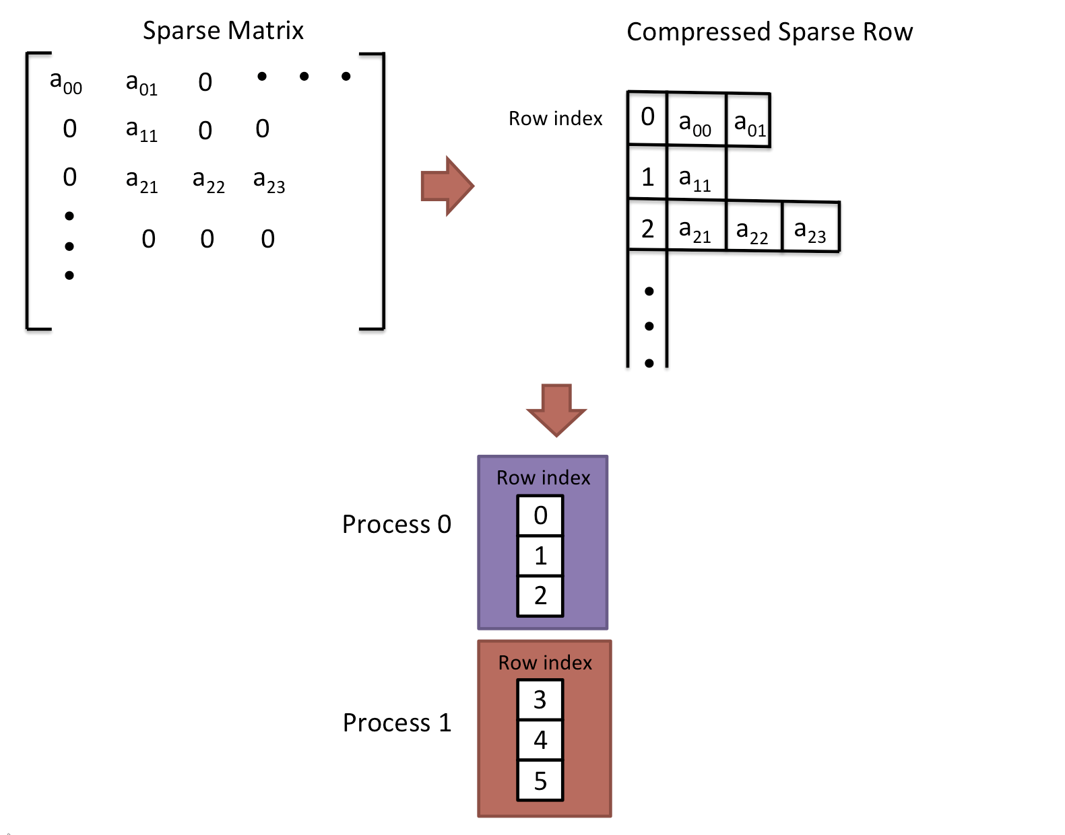
Halo Exchange – Sparse Matrix Vector Multiplication
For a sparse matrix most of the A_{ij} values are zero suggesting that memory would not need to be allocated for every (i,j)-th element.
To avoid storing or manipulating zero entries, the compressed sparse rows format is frequently used:
For each row, all nonzeros of that row are placed in contiguous memory.
In order to achieve data parallelism, the matrix and vector are partitioned into groups of rows assigned to each process.

Slide 37
Halo Exchange – Sparse Matrix Vector Multiplication
The compressed sparse format alters the matrix vector multiplication formula to reflect that zeros are no longer stored nor manipulated:
where n_{i} indicates the number of nonzeros for the i-th row.
Because the rows for both matrix A and vector b are partitioned across several processes, some information will need to be exchanged to evaluate this expression over different sets of data.
(9.8)

Slide 38
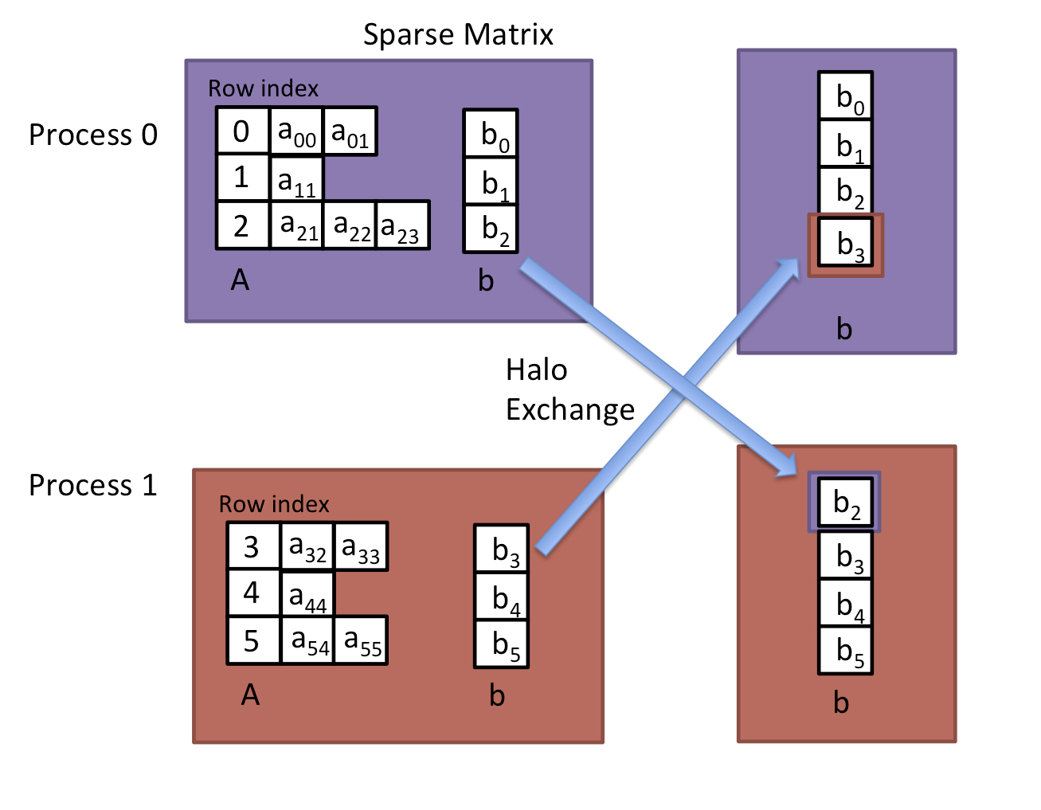
Halo Exchange – Sparse Matrix Vector Multiplication

Slide 39
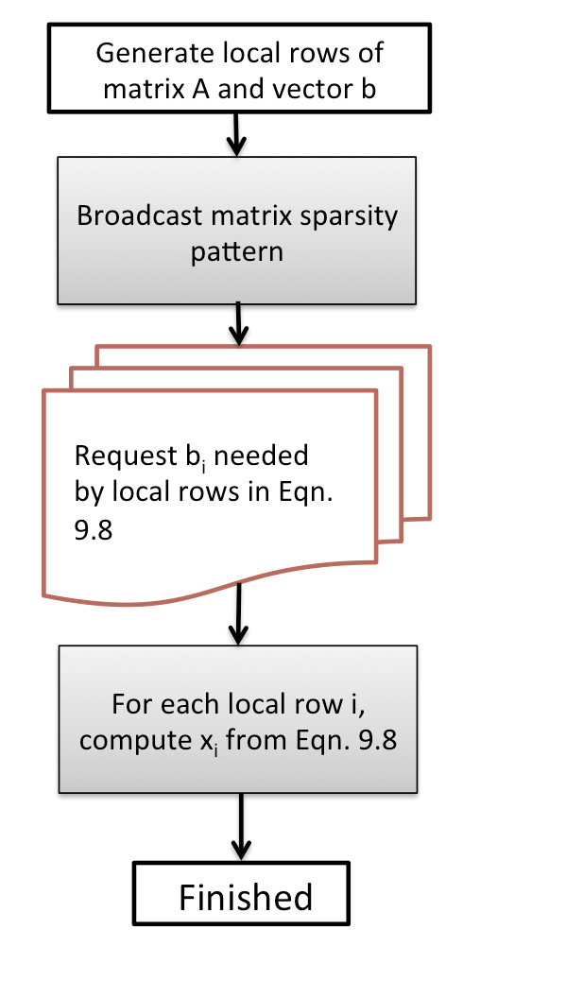
Halo Exchange – Sparse Matrix Vector Multiplication

Slide 40
Permutation: Cannon’s Algorithm
Among algorithms which rely upon a data parallelism approach where the same algorithm is applied to different data in order to extract concurrency, a certain subclass of problem relies upon iterative permutation routing operations to perform all-to-all operations iteratively.
This type of parallel algorithm is very frequent used in applications requiring a linear algebra transpose operation or some type of matrix-matrix multiplication.
Here we explore one such example: Cannon’s algorithm for dense matrix-matrix.

Slide 41
Cannon’s Algorithm
Matrix-matrix multiplication for two N x N matrices A and B is given by:
where the subscripts indicate the row and column index of the matrix entry.
In order to create a parallel algorithm for this, a good place to start is a block algorithm that distributes sub-blocks of matrices A, B, and C among processes where each sub-block is of size N/P x N/P where P is the number of processes

Slide 42
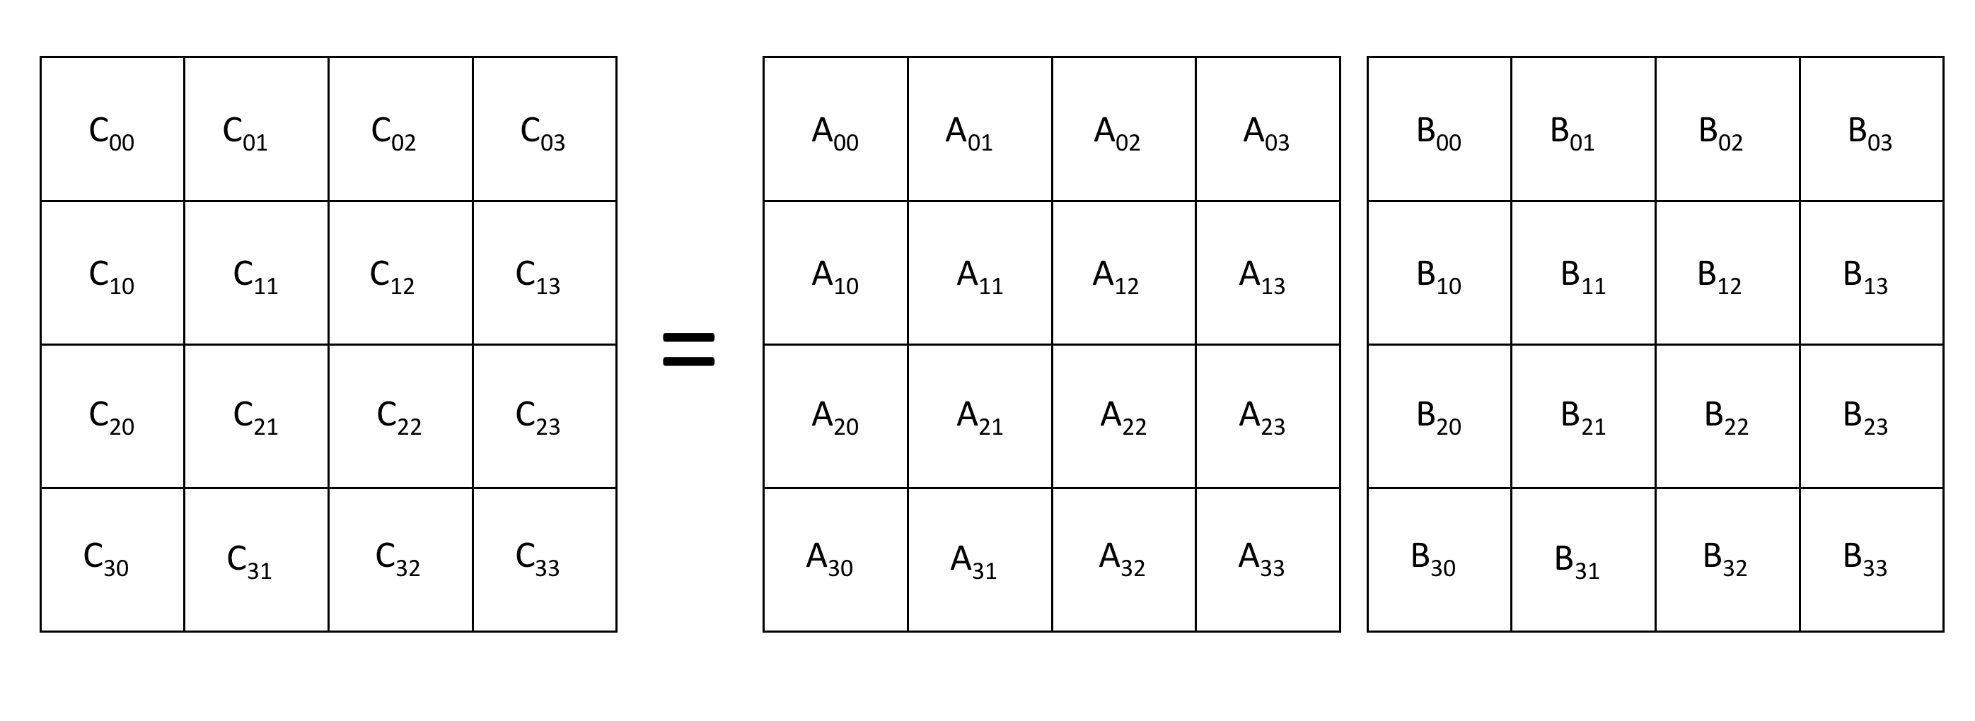
Cannon’s Algorithm
distribute sub-blocks of A, B, and C among processes where each sub-block is of size N/P x N/P where P is the number of processes

Slide 43
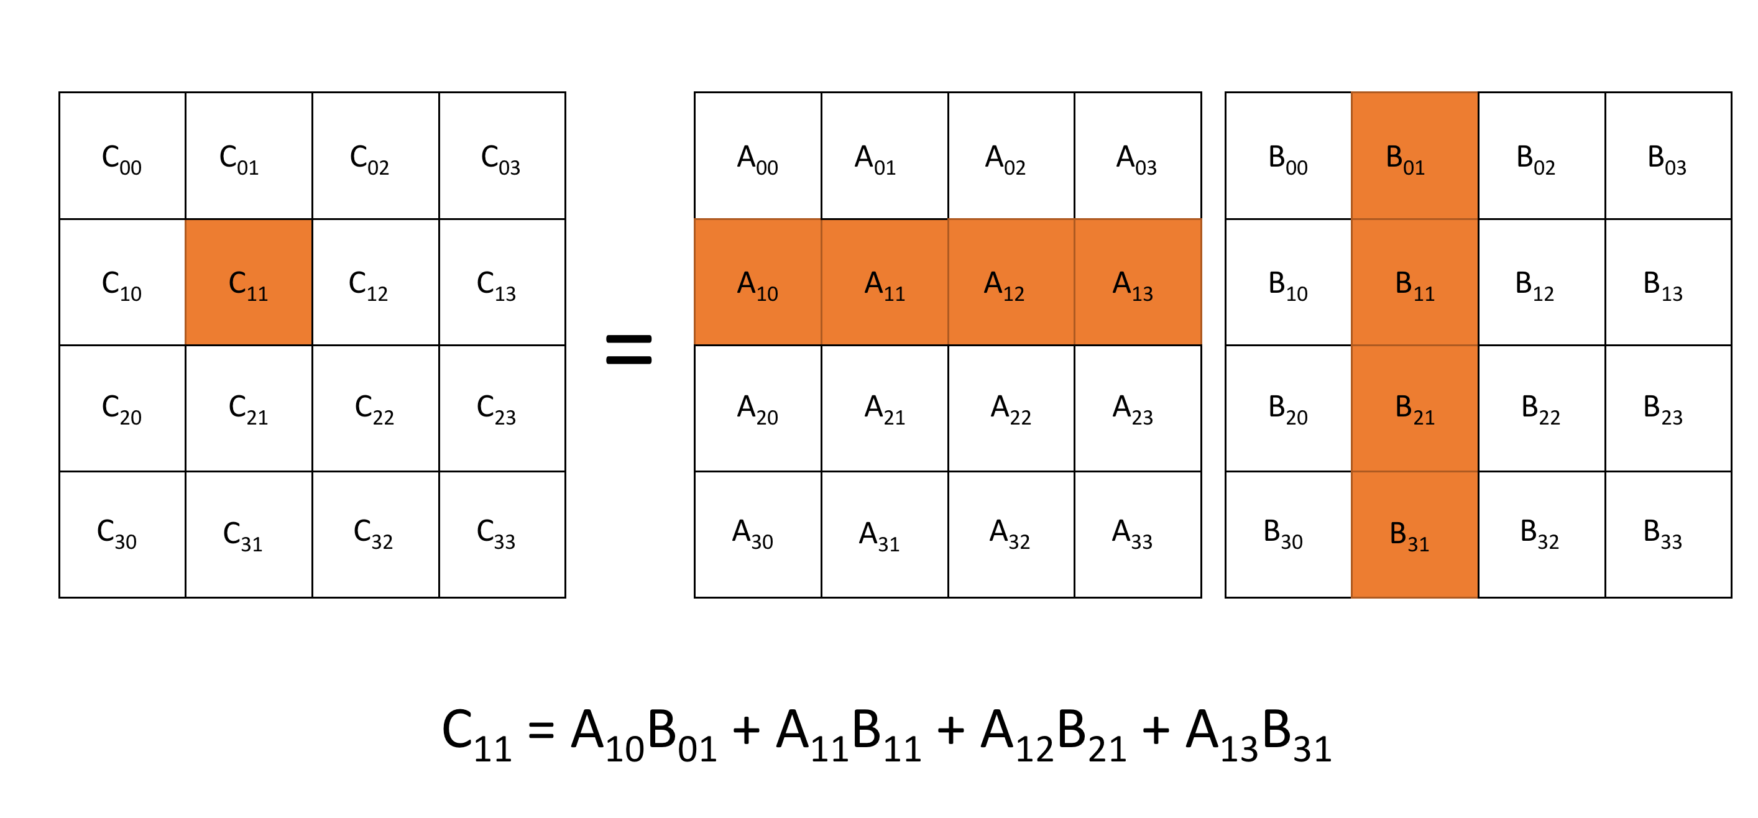
Cannon’s Algorithm
In order to compute the sub-block C₁₁ of the matrix-matrix product of A*B would require computing several serial matrix-matrix products each of size N/sqrt(P) x N/sqrt(P)

Slide 44
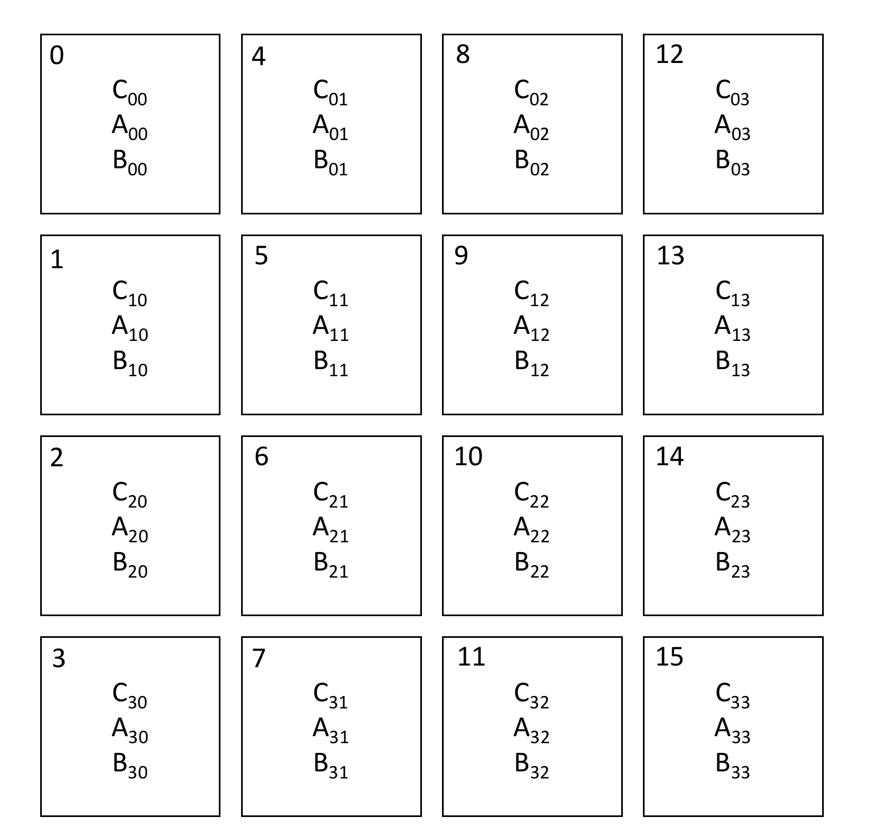
Cannon’s Algorithm
Initially, sub-blocks are mapped to each process as illustrated:

Slide 45
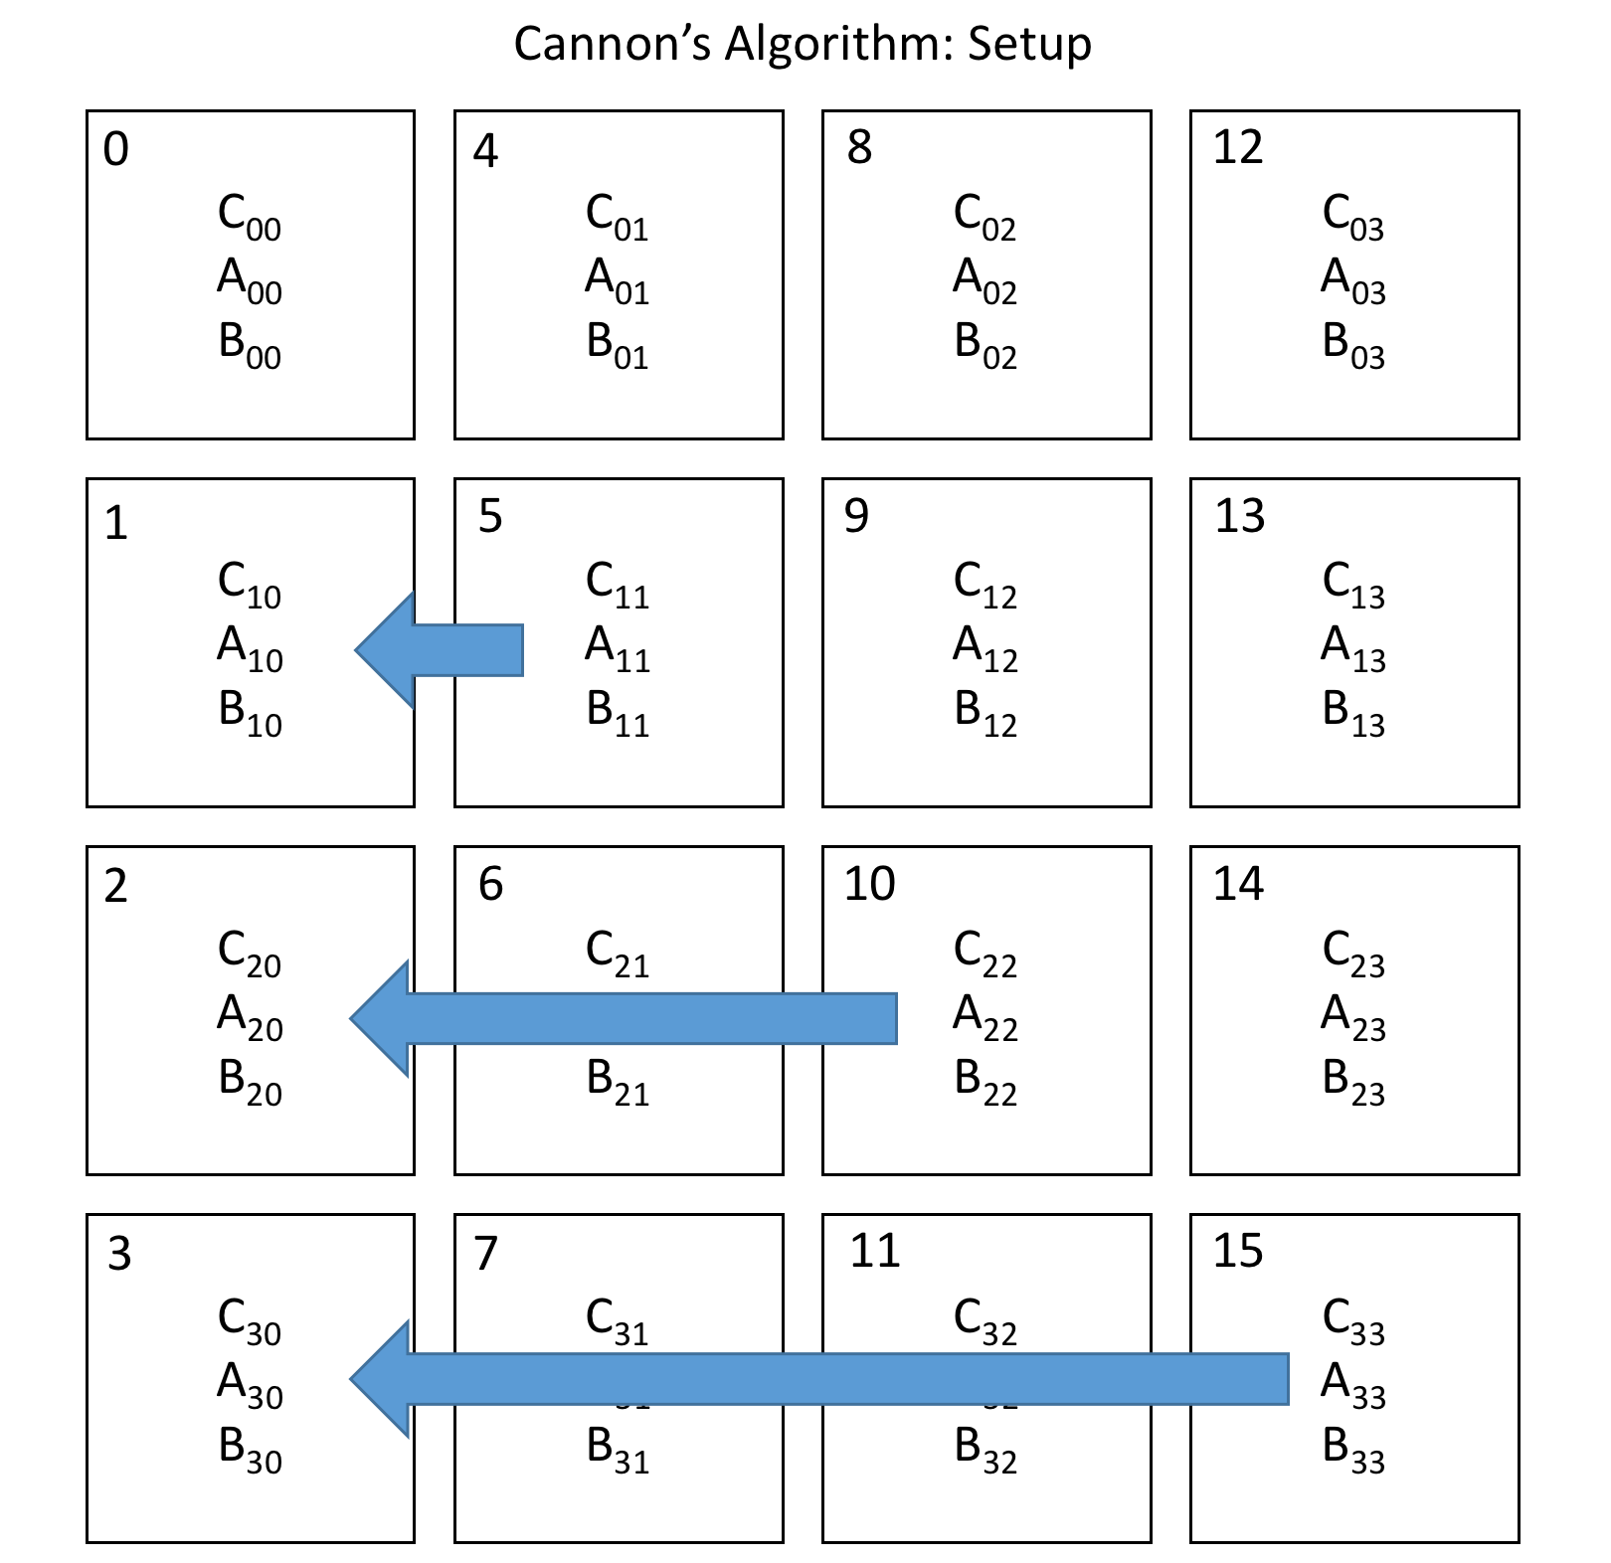
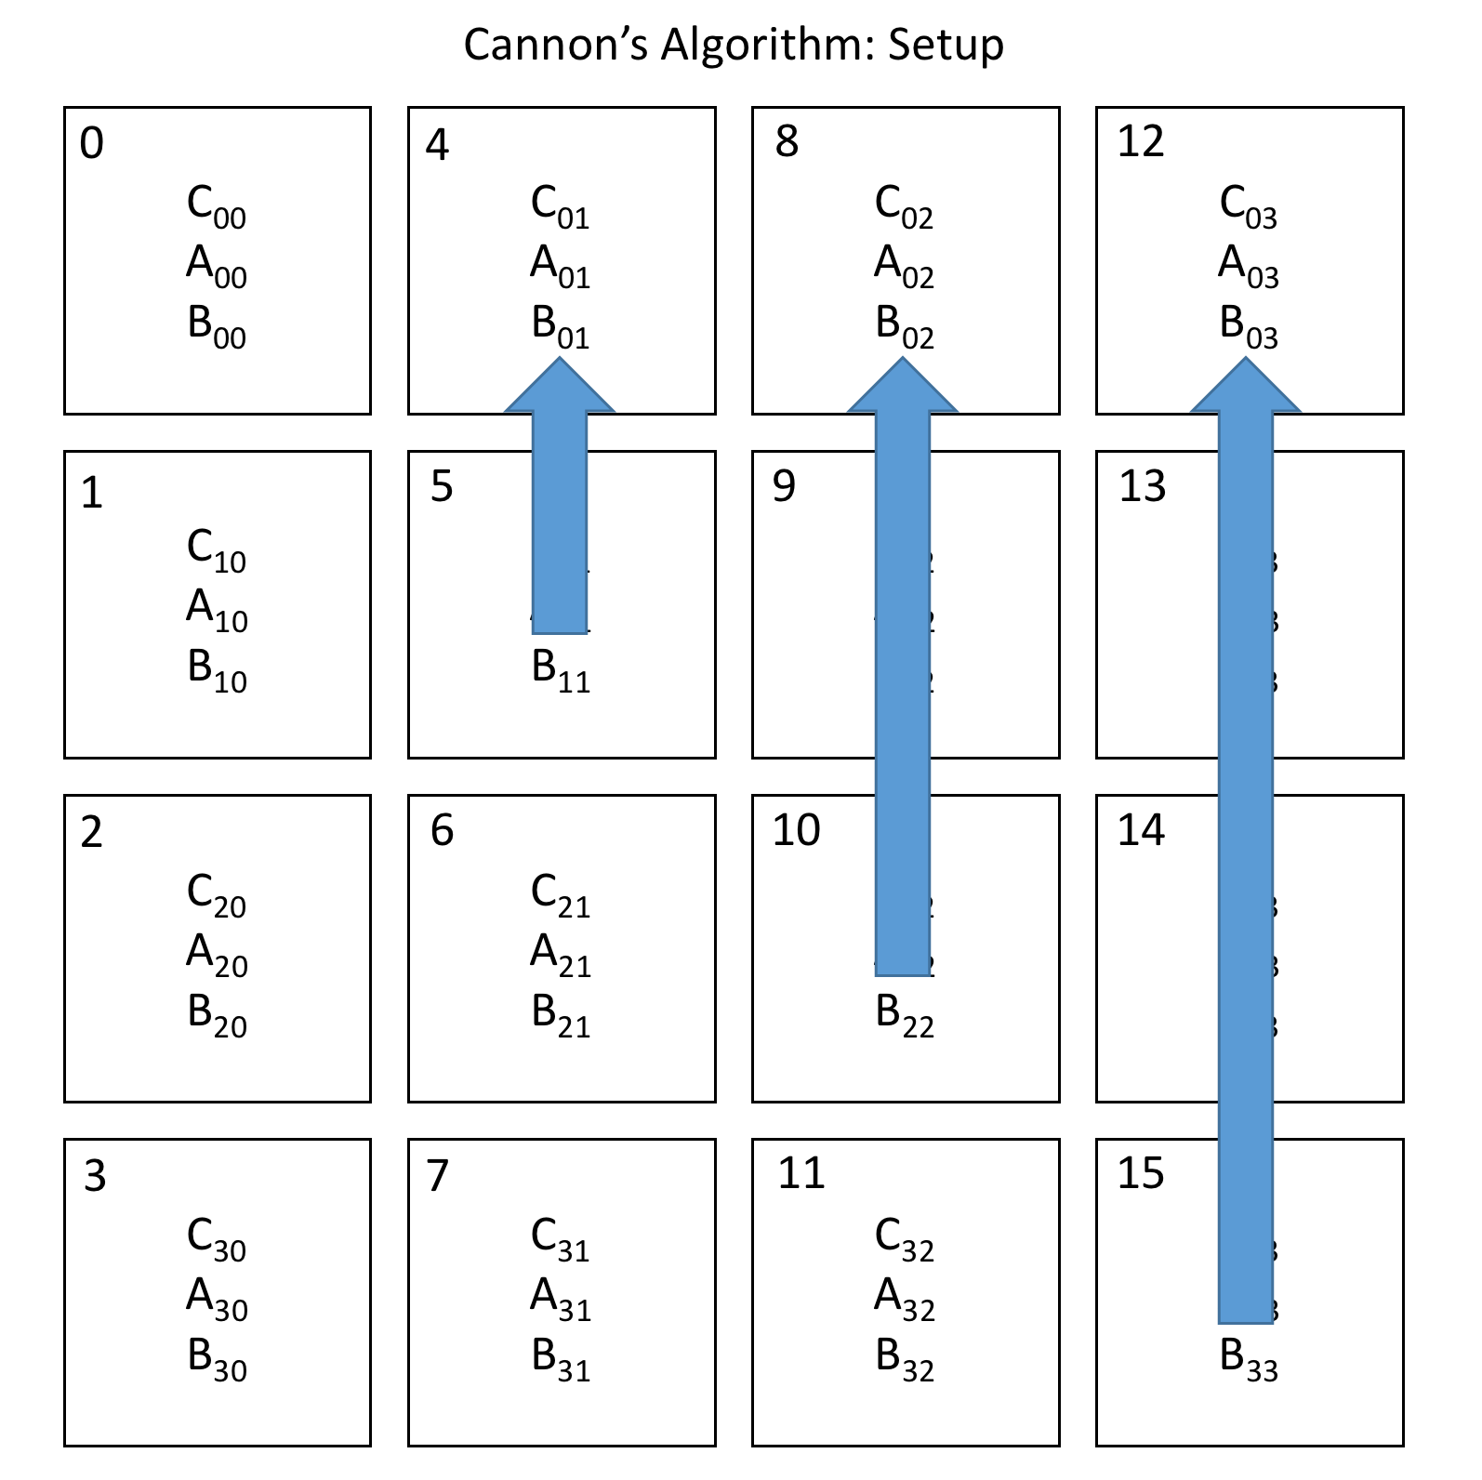
Cannon’s Algorithm
To setup Cannon’s algorithm, the A sub-blocks are shifted to the left while the B sub-blocks are shifted up:

Slide 46
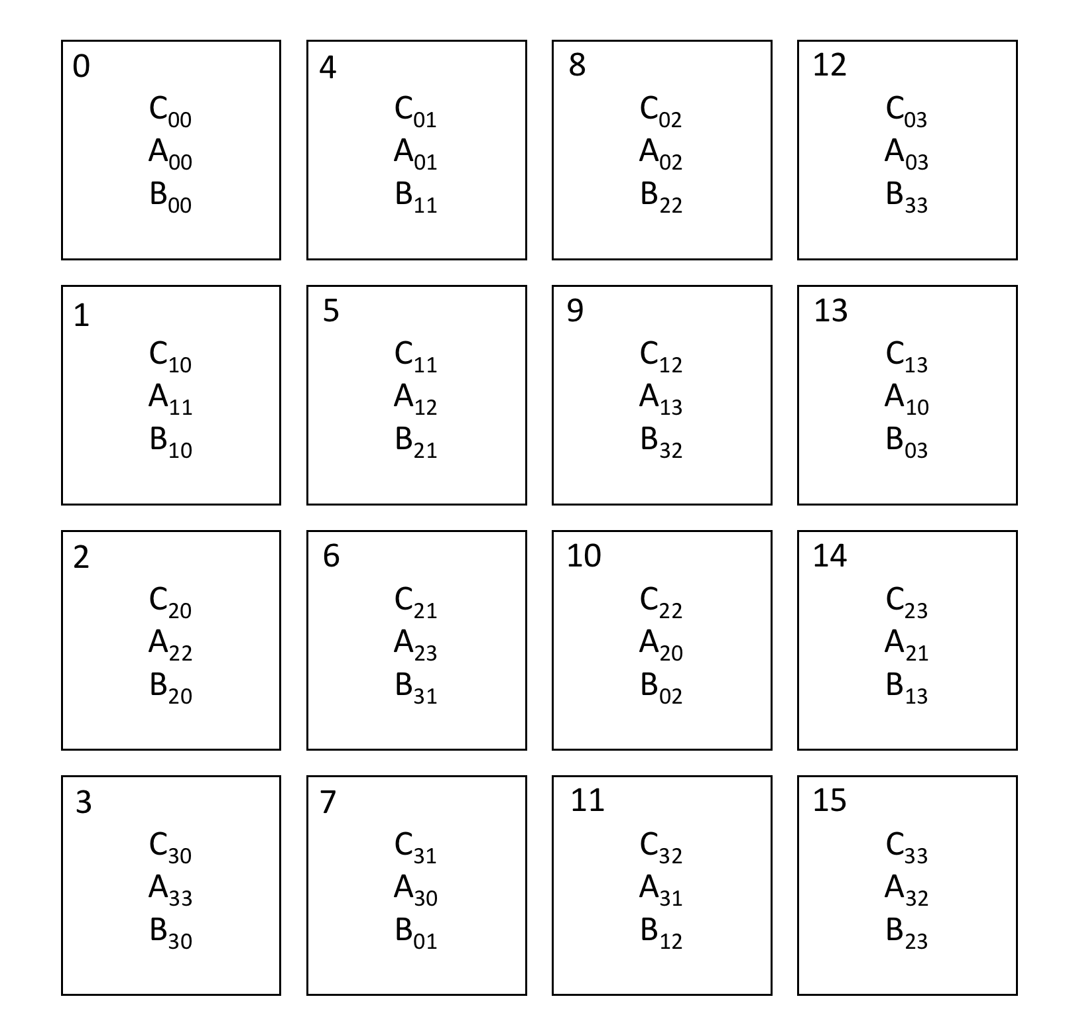
Cannon’s Algorithm
The layout of the matrix sub-blocks after performing the setup permutations:

Slide 47
Cannon’s Algorithm
Cannon’s algorithm consists of moving matrix sub-blocks so that for each iteration k from 0 to 3 matrix sub-blocks A_{i, (i+j+k)} and B _{(i+j+k),j} are located on the same process as C_{ij}.
For each iteration, the partial sum
(9.9)
is accumulated to C_{ij} where each sub-block matrix-matrix multiplication uses the serial matrix-matrix multiplication algorithm previously shown.
The sums in Eqn. 9.9, i+j+k are modulus P (4 in this example). Thus if (i+j+k) = 6, the index in the matrix would become 2.

Slide 48
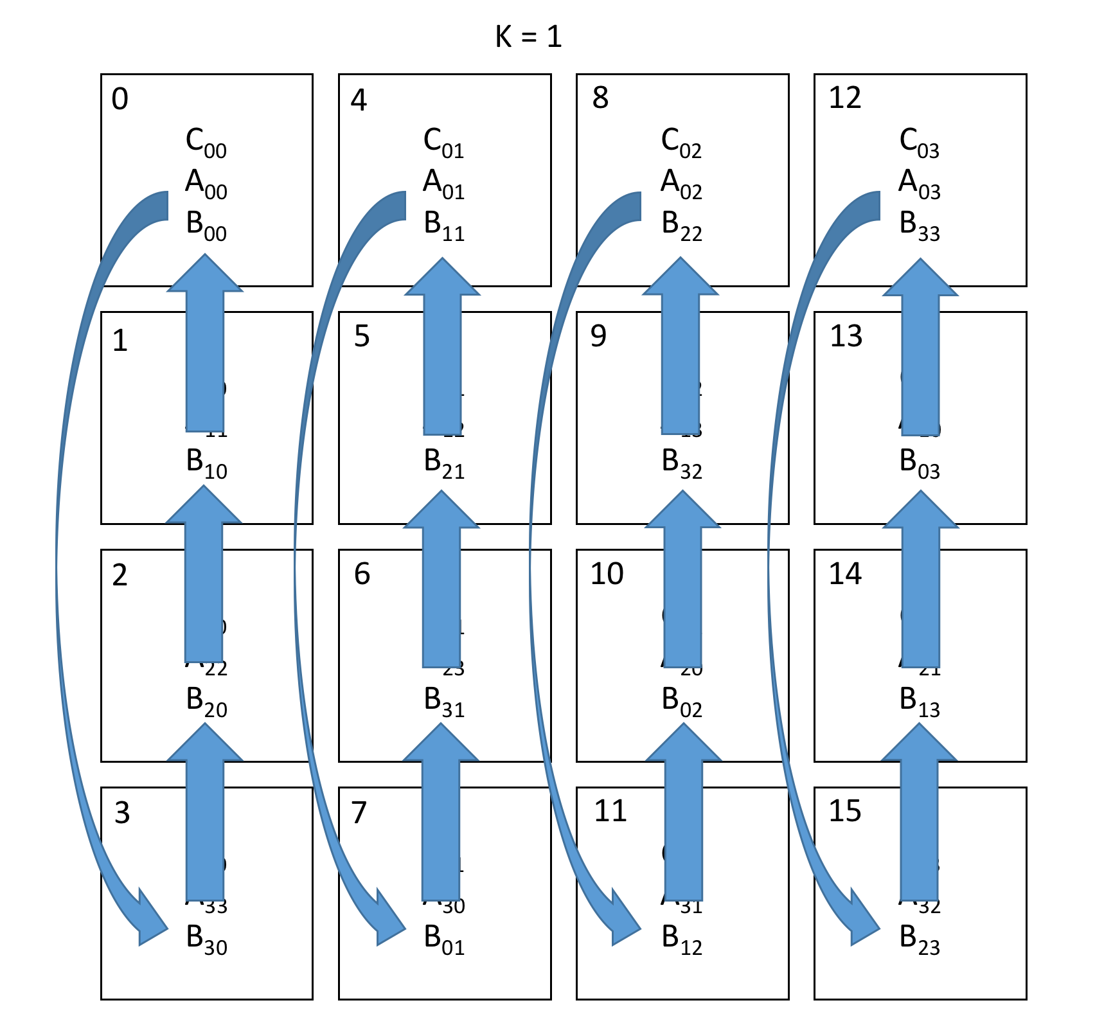
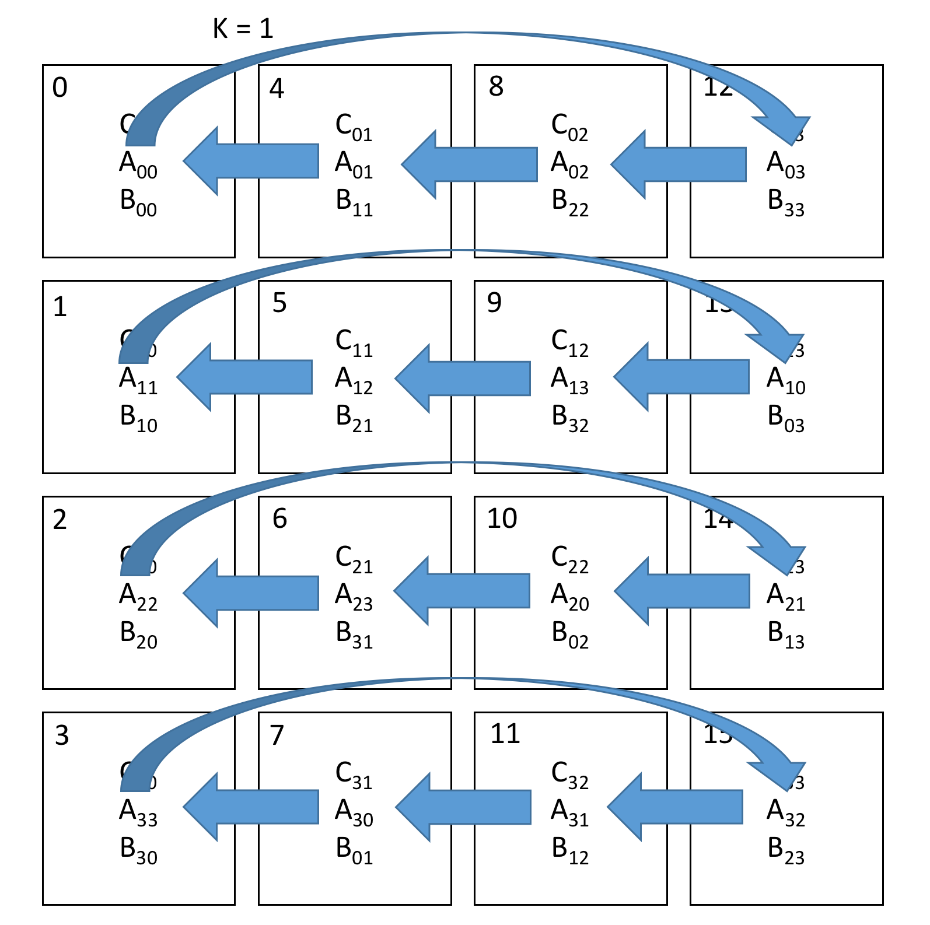
Cannon’s Algorithm
For k=0, Cannon’s algorithm has already been setup.
For every subsequent iteration of k, the A matrices have to be shifted once left and the B matrices have to be shifted up once to satisfy the condition of Eqn. 9.9 and compute the partial sum.

Slide 49
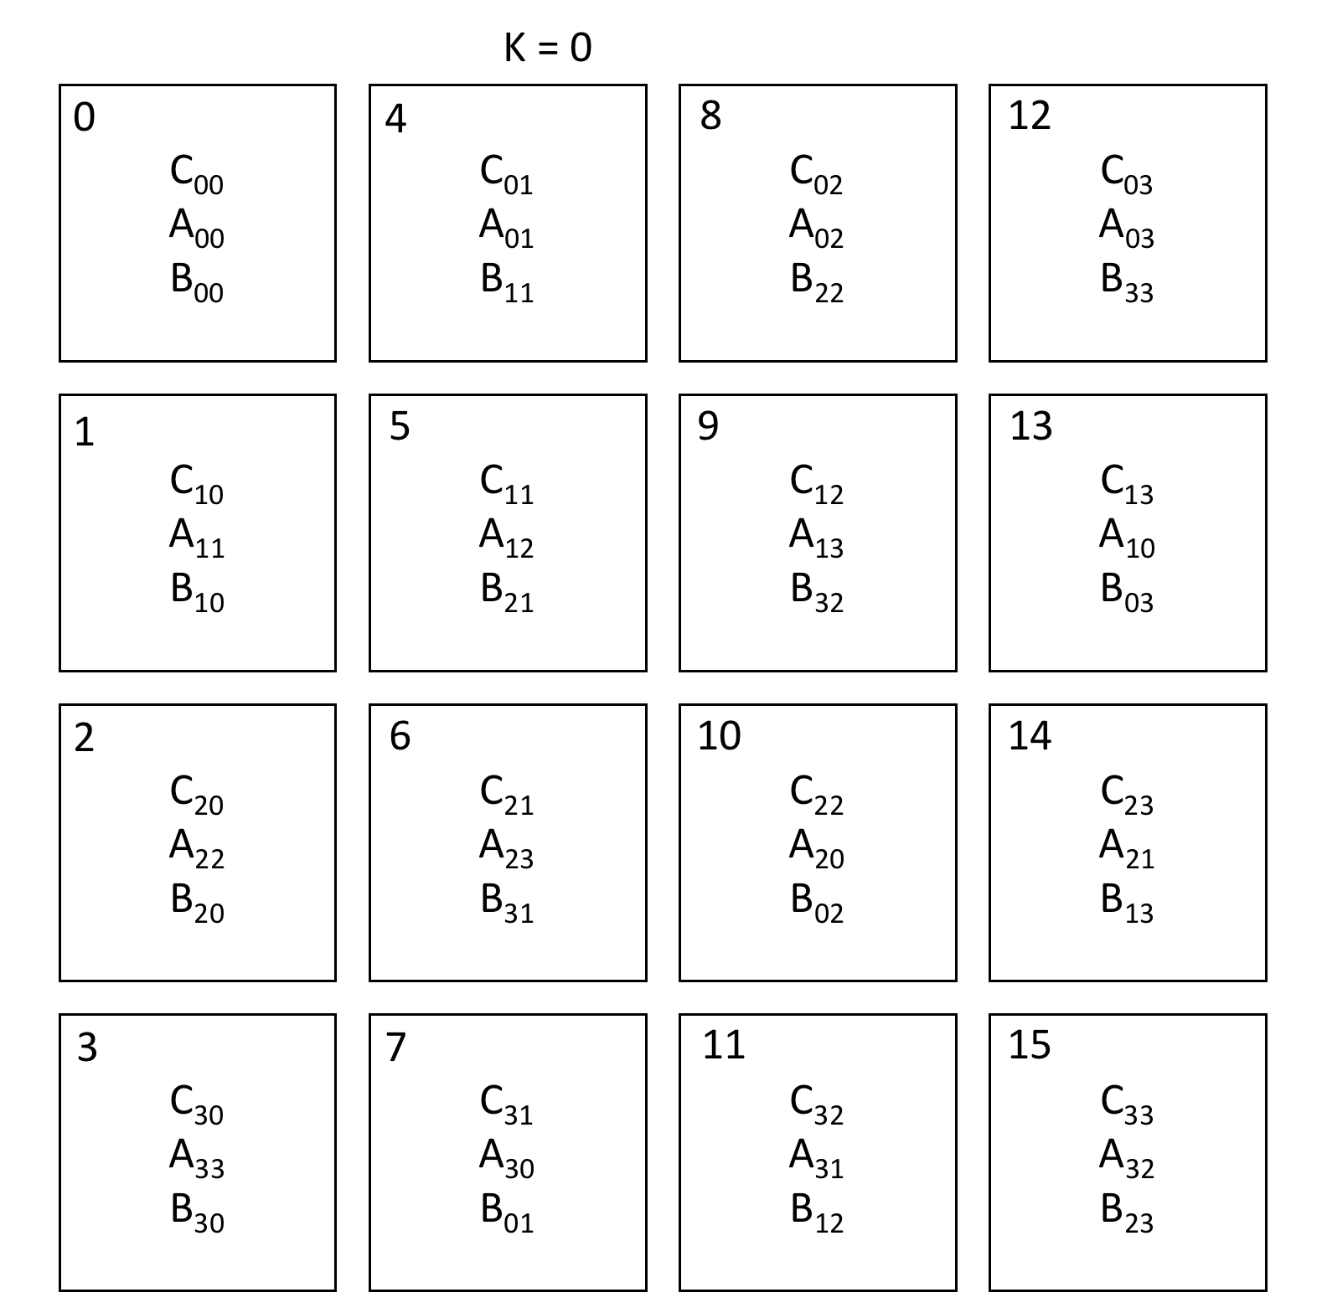
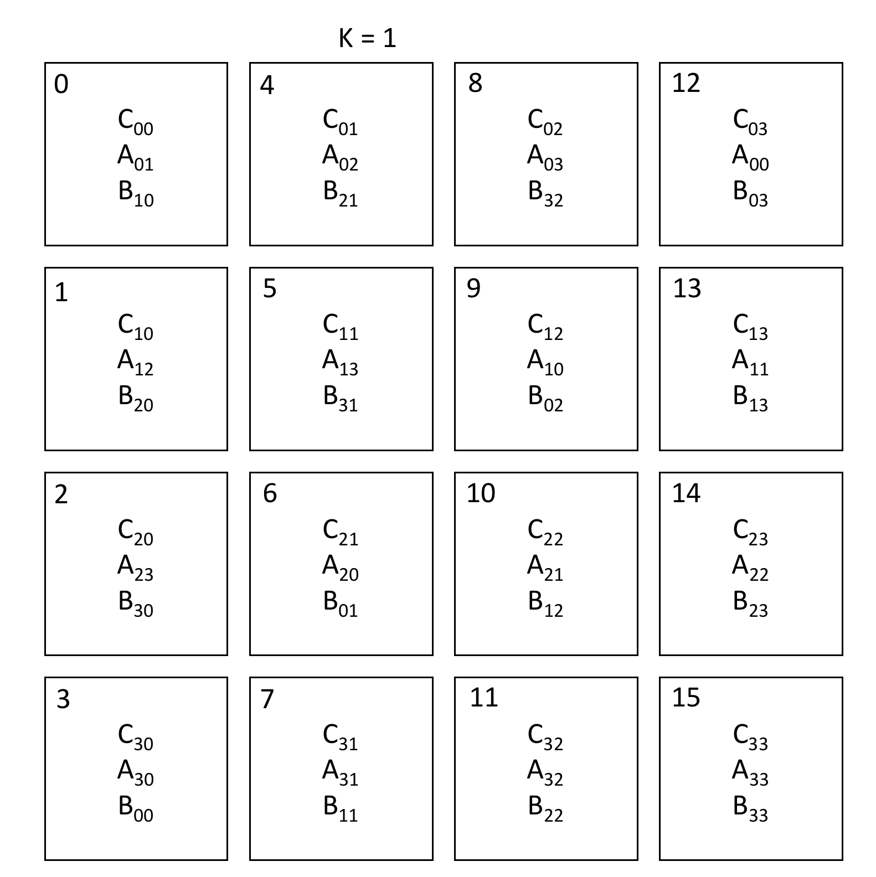
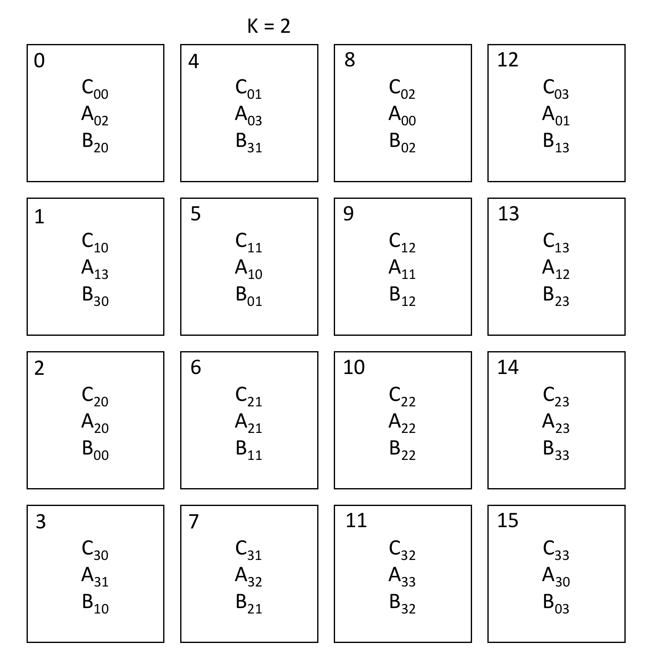
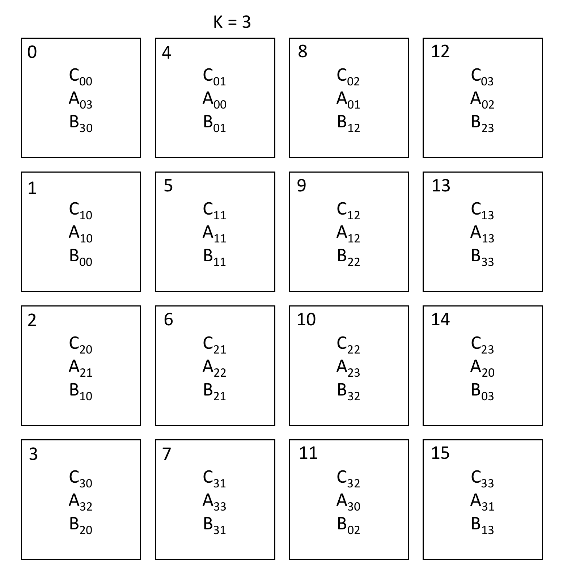
Cannon’s Algorithm
After P iterations of k, the matrix-matrix product has been computed. The resulting matrices for each of the k iterations for P=4 are shown:

Slide 50
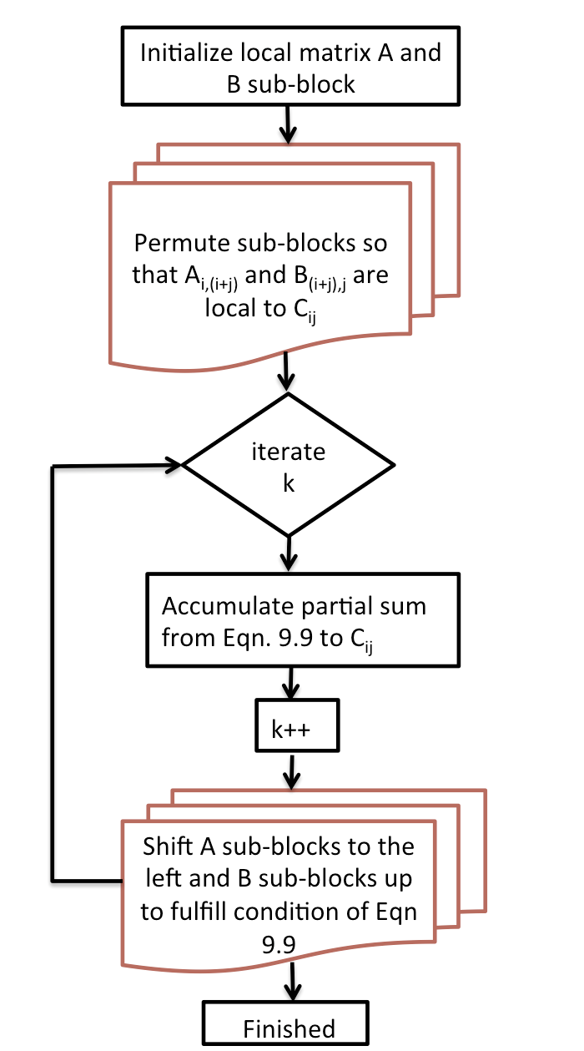
Cannon’s Algorithm

Slide 51
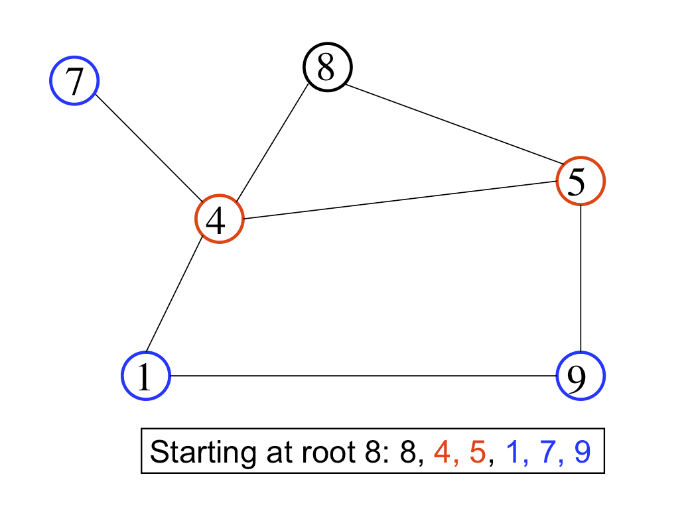
Task Dataflow: Breadth first search
The breadth first search algorithm is used for traversing graph data structures and is a key component of the Graph500 benchmark
A particular root vertex is given to the algorithm to start traversing the graph data structure.
Each adjacent vertex to the root is then traversed and so on thereby establishing the level (or distance) of every vertex from the root.

Slide 52
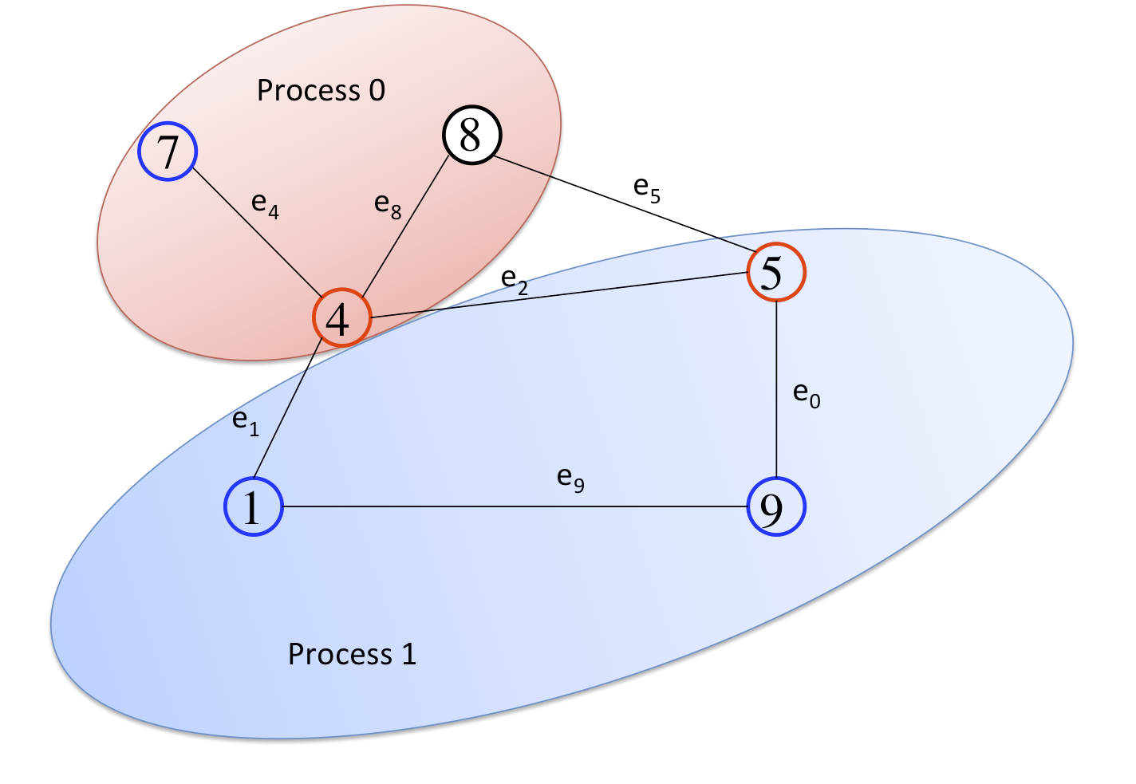
Task Dataflow: Breadth first search
While any parallel algorithm can be expressed as a graph of dependencies, many algorithms that explore graphs themselves are naturally expressed as task dataflow to maximize concurrency.
We use standard parallel breadth first search algorithm as one such example:
Each vertex list is partitioned by process with its edge list

Slide 53
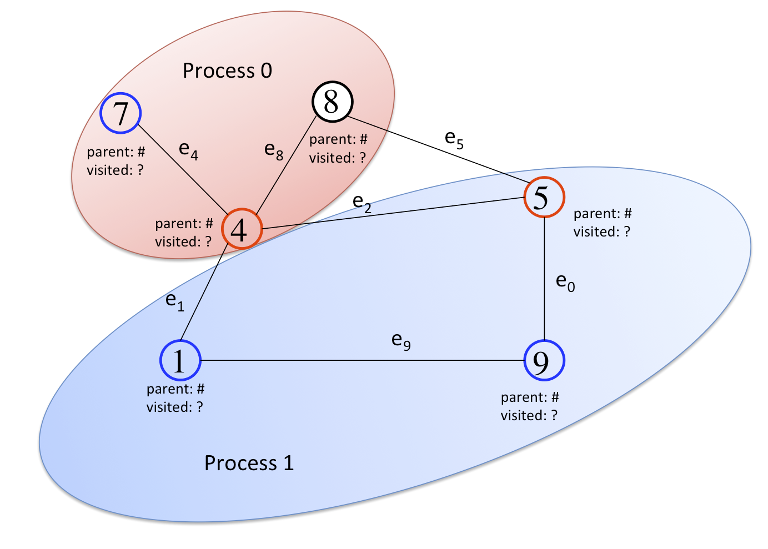
Breadth first search
For each vertex, associate a parent vertex and a binary flag indicating if the vertex has been visited

Slide 54
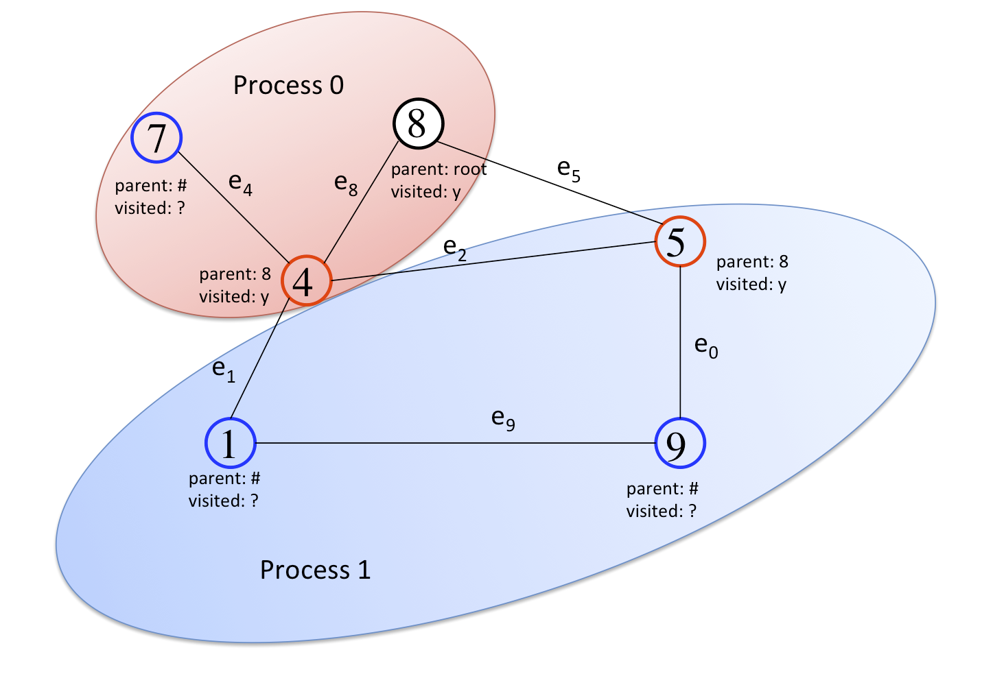
Breadth first search
On each process, scan if new vertices are visited

Slide 55
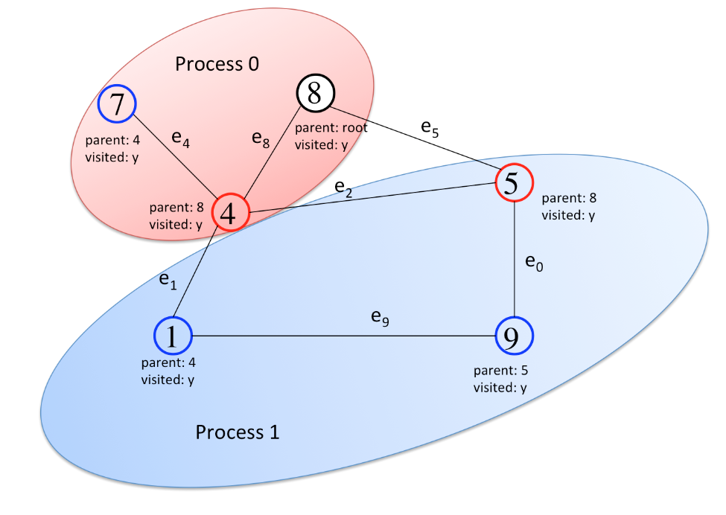
Breadth first search
For each process new vertex visited, follow the edge list and if the vertex is unvisited, set the parent and set to visited

Slide 56
Breadth first search
Level-wise iteration is enforced with two global barriers per level thereby ensuring no out-of-order traversals occur between processes.
An allreduce operation at the checks to see if the algorithm has finished
The concurrency of this breadth first search parallel algorithm is naturally tied to the edge list and the traversal tasks that result from these traversing these edges.
While many parallel algorithms could be recast as task dataflow parallelism, graph and knowledge management applications tend to be naturally expressed using this parallel model.

Slide 57
Parallel Algorithms

Slide 58
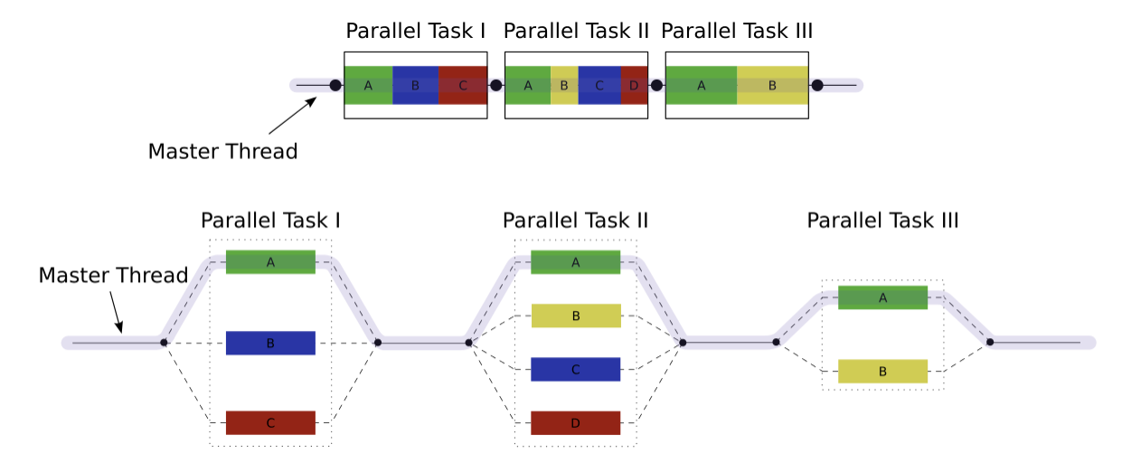
Fork Join
Notes:
https://en.wikipedia.org/wiki/File:Fork_join.svg

Slide 59
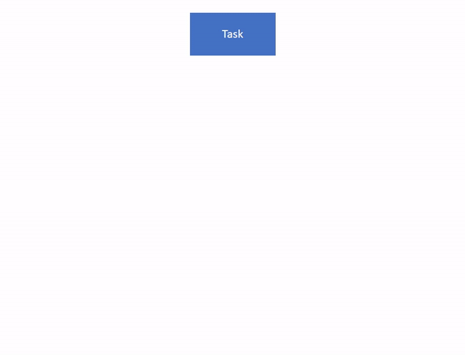
Notes:
https://www.pluralsight.com/guides/introduction-to-the-fork-join-framework

Slide 60
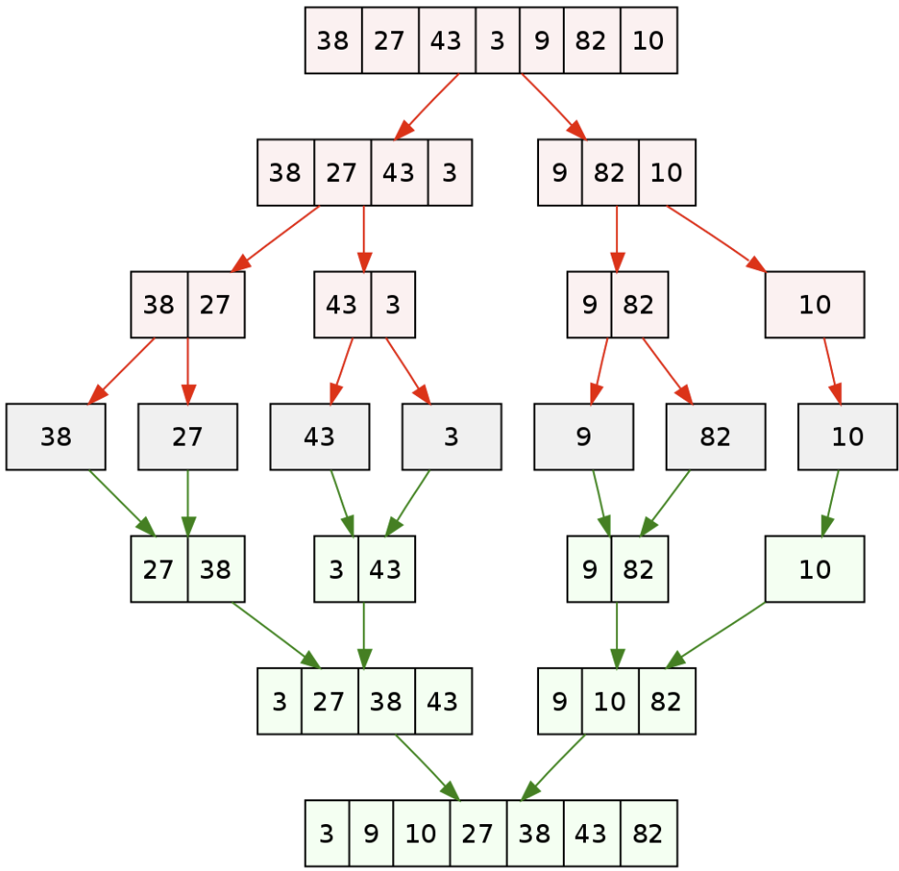
Divide-and-Conquer
Multi branch recursion
Keeps breaking the problem into subproblems of the same type
Notes:
https://en.wikipedia.org/wiki/Divide-and-conquer_algorithm#/media/File:Merge_sort_algorithm_diagram.svg

Slide 61
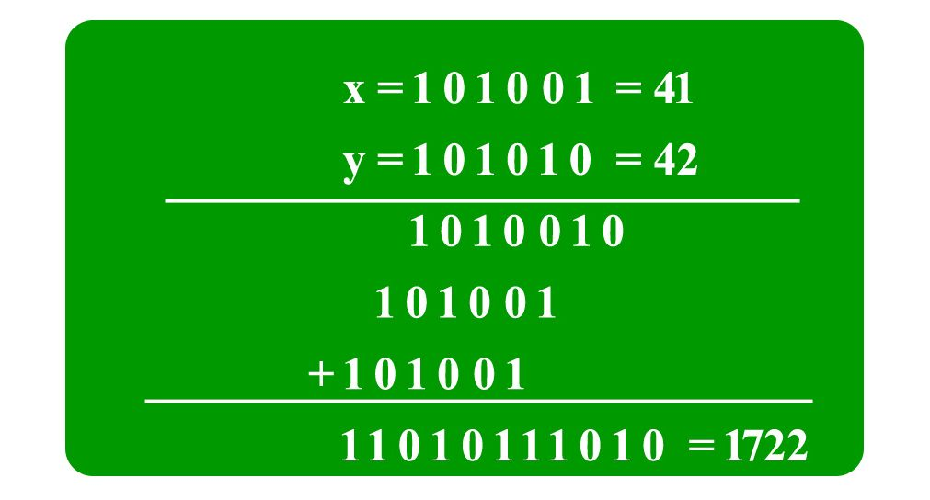
More Interesting Divide And conquer
Karatsuba Algorithm for multiplying many digit numbers
Like the right
But with a bunch of rows of 0
O(n^2)
Notes:
https://www.geeksforgeeks.org/karatsuba-algorithm-for-fast-multiplication-using-divide-and-conquer-algorithm/

Slide 62

Divide up the problem
(where l and r are the left and right bits of the number, n is the number of bits)
$X=Xl∗2^{\frac{n}{2}}+Xr$ [Xl and Xr contain leftmost and rightmost n/2 bits of X]
$Y=Yl∗2^{\frac{n}{2}}+Yr$ [Yl and Yr contain leftmost and rightmost n/2 bits of Y]
$XY=\left(Xl∗2^{\frac{n}{2}}+ Xr\right)\left(Yl∗2^{\frac{n}{2}}+ Yr\right)$
$XY=2^{n}XlYl +2^{\frac{n}{2}}(XlYr + XrYl) + XrYr$

Slide 63

Another way of writing it (base r)
$a=X_{H}Y_{H}$
$d=X_{L}Y_{L}$
$e={(X_{H}+X}_{L}){(Y_{H}+Y}_{L})−a−d$
Then
$xy=ar^{n}+er^{\frac{n}{2}}+d$

Slide 64


Example
$a=X_{H}Y_{H}$
$d=X_{L}Y_{L}$
$e={(X_{H}+X}_{L}){(Y_{H}+Y}_{L})−a−d$
Then
$xy=ar^{n}+er^{\frac{n}{2}}+d$
1234*4321
$a_{1}=12∗43$
$d_{1}=34∗21$
$e_{1}=\left(12+34\right)∗\left(43+21\right)−a_{1}−d_{1}$
So we need to compute a1 and d1 and e1 (see where recursion comes in?)

Slide 65


$a=X_{H}Y_{H}$
$d=X_{L}Y_{L}$
$e={(X_{H}+X}_{L}){(Y_{H}+Y}_{L})−a−d$
Then
$xy=ar^{n}+er^{\frac{n}{2}}+d$
First subproblem
$a_{1}=12∗43$
$a_{2}=1∗4=4$
$d_{2}=2∗3=6$
$e_{2}=\left(1+4\right)∗\left(4+3\right)−a_{2}−d_{2}$
$e_{2}=11$
$a_{1}=\left(4∗{10}^{2}+11∗10+6\right)=516$

Slide 66

$a=X_{H}Y_{H}$
$d=X_{L}Y_{L}$
$e={(X_{H}+X}_{L}){(Y_{H}+Y}_{L})−a−d$
Then
$xy=ar^{n}+er^{\frac{n}{2}}+d$
Second subproblem
$d_{1}=34∗21$
$a_{2}=3∗2=$6
$d_{2}=4∗1=4$
$e_{2}=\left(3+4\right)∗\left(2+1\right)−a_{2}−d_{2}$
$e_{2}=11$
$d_{1}=\left(6∗{10}^{2}+11∗10+4\right)=714$

Slide 67

$a=X_{H}Y_{H}$
$d=X_{L}Y_{L}$
$e={(X_{H}+X}_{L}){(Y_{H}+Y}_{L})−a−d$
Then
$xy=ar^{n}+er^{\frac{n}{2}}+d$
Third subproblem
$e_{1}=46∗64−a_{1}−d_{1}$
$a_{2}=4∗6=24$
$d_{2}=6∗4=24$
$e_{2}=\left(4+6\right)∗\left(6+4\right)−a_{2}−d_{2}$
$e_{2}=52$
$e_{1}=\left(24∗{10}^{2}+52∗10+24−714−516\right)=1714$

Slide 68


Final Answer
$a=X_{H}Y_{H}$
$d=X_{L}Y_{L}$
$e={(X_{H}+X}_{L}){(Y_{H}+Y}_{L})−a−d$
Then
$xy=ar^{n}+er^{\frac{n}{2}}+d$
$1234∗4321$
$a_{1}=516$
$d_{1}=714$
$e_{1}=1714$
$1234∗4321=516∗{10}^{4}+1714∗{10}^{2}+714=5332114$
Go us

Slide 69
Halo Exchange
This is where you have neighbouring elements that need to be exchanged between an otherwise parallelised task
http://wgropp.cs.illinois.edu/courses/cs598-s16/lectures/lecture25.pdf
http://wgropp.cs.illinois.edu/courses/cs598-s16/lectures/lecture27.pdf

Slide 70

Mesh Exchange – General Idea

Slide 71
Details?
The ordering in which data is passed around, and what you do when waiting for data will matter to optimisation
Some of that will depend on your network topology too
If you do a breadth first/Depth first sending of data, the last node ends up taking a long time to get the data
Ideally (if bandwidth allows) You want to interleave your data transmissions that all happen at once

Slide 72


Slide 73


Slide 74


Slide 75

Permutation
E.g. Cannon’s algorithm for matrix multiplication
The idea is that a process can multiply sub matrices, but which ones?
You need to permute the data to the right place for the calculations

Slide 76

Manager Worker
Pretty much what it sounds like
There’s a main/master/manager process that manages the secondary/slave/worker processes
Notes:
https://www.researchgate.net/figure/Example-manager-worker-application-with-three-intercommunicators-connnecting-separate_fig1_220457305

Slide 77

Task Dataflow
Workflow composed by multiple steps. Each operation can be treated as an independent computation.
Notes:
https://www.dotnetcurry.com/patterns-practices/1483/parallel-workflow-dotnet-tpl-dataflow

Slide 78

Task Parallel Library Dataflow
Ok so now we have a queue and a parallel region where the task is parallelised (that’s the task parallel part)

Slide 79


Slide 80
End WI 2020 supplemental

Slide 81

The News
512 nodes, total 8192 375Mhz IBM processors
6TB of memory, 160TB of storage
12 Tflops of performance.
Was for nuclear weapons design/testing simulation (after the test ban treaties in the 1990s)
Xbox4 -> also 12 Tflops.
Notes:
https://twitter.com/ZhugeEX/status/1231994961178087425?s=19

Slide 82
Libraries

Slide 83

Libraries
Widely varying computational science disciplines use a significant amount of the available high performance computing resources.

Slide 84
Purpose of libraries
Portability – tuned to perform across a wide range of architectures
Performance – tuned over a decade or more for performance
Code-reuse -- Avoid wasting developer time in re-developing software for a core operation shared across many research areas
Enable vendors to tune implementations for emerging hardware
Strongly support benchmarking efforts, sometimes even resulting in symbiotic relationships, e.g. BLAS and LINPACK.

Slide 85
Widely Used HPC libraries and their Application Domain
Application Domain | Widely Used Libraries on High Performance Computing Systems
Linear Algebra | BLAS, LAPACK, ScaLAPACK, GNU Scientific Library, SuperLU, PETSc, SLEPc, ELPA, Hypre
Partial Differential Equations | PETSc, Trilinos
Graph Algorithms | Boost Graph Library, Parallel Boost Graph Library
I/O | HDF5, Netcdf, Silo
Mesh Decomposition | METIS, ParMETIS
Visualization | VTK
Parallelization | Pthreads, MPI, Boost MPI
Signal Processing | FFTW
Performance Monitoring | PAPI, Vampir

Slide 86

Examples of Library Dependencies in Common HPC Applications
Blue – core linear algebra libraries, Red – application frameworks dependent on core linear algebra libraries, Green -- dependencies

Slide 87



BLAS
BLAS level 1 provided a standard, machine independent application interface to vector routines optimized for specific computer architectures
The BLAS idea is credited to Charles Lawson and Richard Hanson at the Jet Propulsion Laboratory in the 70’s.
Lawson, Hanson, F. Krogh, D.R. Kincaid and Jack Dongarra were responsible for the conception, design and implementation of the BLAS.
Stands for Basic Linear Algebra Subprograms (the term “subprograms” is a Fortran term referring to functions and subroutines)
BLAS development was conducted in conjunction with the LINPACK project undertaken by Argonne National Laboratory, and the two projects proved symbiotic.
LINPACK was the first major package to use BLAS.

Slide 88

CDC 7600
BLAS Level 1 was motivated by the CDC 7600 with an instruction cache of 16 instructions
The world’s fastest computer from 1969– 1975 (up to 36 Mflops)
Successor to the world’s first ”supercomputer”, the CDC 6600
Designed by Seymour Cray
Generally required hand compiled assembly code to achieve good performance.
“You didn’t want to do that with a big piece of software, and so it focused the idea on identifying small pieces of software that are significant in the overall running time of the program. Of course in linear equation solving, it’s the classic case. ” --Charles Lawson on why BLAS was created.

Slide 89
BLAS
The first BLAS routines were 10-15 routines and were just vector operations (inner products, norms, adding vectors, scalar multiplication, etc)
The original BLAS dealt only with one level of looping, essentially with vectors rather than matrices because the cache size on the CDC 7600 machines was so small that there wasn’t any point in doing matrices.
1987 – Level 2 BLAS: Matrix-vector operations (about 10 years after Level 1 BLAS)
1989 – Level 3 BLAS: Matrix-matrix operations

Slide 90
BLAS
Several implementations for different languages exist
Reference implementation (F77 and C-wrapper) http://www.netlib.org/blas/
ATLAS, highly optimized for particular processor architectures
A generic C++ template class library providing BLAS functionality: uBLAS http://www.boost.org
Several vendors provide libraries optimized for their architecture (AMD, HP, IBM, Intel, NEC, NViDIA, Sun)
55

Slide 91
The core BLAS precision prefixes
Prefix | Description
s | Single precision (float), 4 bytes
d | Double precision (double), 8 bytes
c | Complex, (two floats), 8 bytes
z | Complex*16, (two doubles), 16 bytes

Slide 92

BLAS Level 1 operations : Vector Rotations
Name | Description | Supported Precisions
rotg | Computes the parameters for a Givens rotation. That is, given scalars a and b, compute c and s so that $$\left(\begin{matrix}c & s \\ −s & c\end{matrix}\right)\left(\begin{matrix}a \\ b\end{matrix}\right)= \left(\begin{matrix}r \\ 0\end{matrix}\right)$$ where $r= \sqrt{{|a|}^{2}+{|b|}^{2}}$ | s,d
rot | Applies the Givens rotation. That is, provided two vectors as input, x and y, each vector element is replaced as follows: $$x_{i}=cx_{i}+sy_{i}$$ $$y_{i}= −sx_{i}+cy_{i}$$ where c and s are the parameters for the Givens rotation (See rotg). | s,d
rotmg | Computes the 2 x 2 modified Givens rotation matrix $$H=\left(\begin{matrix}h_{11} & h_{12} \\ h_{21} & h_{22}\end{matrix}\right)$$ That is, given scaling factors $d_{1}$ and $d_{2}$ with Cartesian coordinates ($x_{1},y_{1}$) of an input vector, compute the modified Givens rotation matrix H such that $$\left(\begin{matrix}x_{1} \\ 0\end{matrix}\right)=H\left(\begin{matrix}x_{1}\sqrt{d_{1}} \\ y_{1}\sqrt{d_{2}}\end{matrix}\right)$$ | s,d
rotm | Applies the modified Givens rotation. That is, provided two vectors, x and y, compute: $$\left(\begin{matrix}x_{i} \\ y_{i}\end{matrix}\right)=\left(\begin{matrix}h_{11} & h_{12} \\ h_{21} & h_{22}\end{matrix}\right)\left(\begin{matrix}x_{i} \\ y_{i}\end{matrix}\right)$$ where $h_{ij}$ are the elements of the modified Givens rotation matrix (See rotmg). | s,d

Slide 93

BLAS Level 1 operations : Vector Operations without a dot product
Name | Description | Supported Precisions
swap | Swaps vectors $$x↔y$$ | s,d,c,z
scal | Scales a vector by a constant $$y= αy$$ | s,d,c,z,cs,zd
copy | Copies a vector $$y=x$$ | s,d,c,z
axpy | Updates a vector $$y=αx+y$$ | s,d,c,z

Slide 94

BLAS Level 1 operations : Vector Operations with a dot product
Name | Description | Supported Precisions
dot | Dot product $$x^{T}y$$ | s,d,ds
dotc | Complex conjugate dot product $$x^{h}y$$ | c,z
dotu | Complex dot product $$x^{T}y$$ | c,z
sdsdot | Dot product plus a scalar $$α+ x^{T}y$$ | sds

Slide 95

BLAS Level 1 operations : Vector Norms
Name | Description | Supported Precisions
nrm2 | Compute the 2-norm $${|\left|x\right||}_{2}=\sqrt{\sum{{{|x}_{i}|}^{2}}}$$ | s,d,sc,dz
asum | Compute the 1-norm $${|\left|x\right||}_{1}=\sum{|x_{i}|}$$ | s,d,sc,dz
i_amax | Compute the $∞$-norm $${|\left|x\right||}_{∞}=max(\left|x_{i}\right|)$$ | s,d,c,z

Slide 96

Matrix Types supported in BLAS Level 2 and 3
Matrix Type | Description
General: ge, gb | General, nonsymmetric, possibly rectangular matrix
Symmetric: sy,sb,sp | Symmetric matrix. This is a special class of square matrix that is equal to its own transpose. So for matrix A with elements $a_{ij}$, a symmetric matrix would have elements which satisfy $a_{ij}=a_{ji}$.
Hermitian: he,hb,hp | Hermitian matrix. This is a special class of square matrix that is equal to its own Hermitian conjugate. So for matrix A with elements $a_{ml},$ matrix A is Hermitian if all elements satisfy $a_{ml}=\overline{a_{lm}}$ where the overbar is the complex conjugate.
Triangular: tr,tb,tp | Triangular matrix. This is a special class of square matrices where all the entries above the diagonal are zero (lower triangular) or all the entries below the diagonal are zero (upper triangular).

Slide 97

BLAS Level 2 and Level 3 operations
Name | Description
mv | Matrix-vector product
sv | Solve matrix (only for triangular matrices)
mm | Matrix-matrix product, $C= αAB+ βC$ where $A,B, C$ are matrices and $α, β$ are scalars
rk | Rank-k update, $C= αAA^{T}+βC$ where $A, C$ are matrices and $α, β$ are scalars
r2k | Rank-2k update, $C= αAB^{T}+\overline{α}BA^{T}+βC$ where $A,B, C$ are matrices and $α, β$ are scalars

Slide 98

Example CBLAS DGEMM
Order indicates the storage layout as either row-major or column-major. This input is either CblasRowMajor or CblasColMajor.
TransA indicates whether to transpose matrix A. This input is either CblasNoTrans, CblasTrans, or CblasConjTrans indicating no transponse, transpose, or complex conjugate transpose, respectively.
TransB indicates whether to transpose matrix B. Acceptable options are the same as those listed for A.
M indicates the number of rows in matrices A and C.
N indicates the number of columns in matrices B and C.
K indicates the number of columns in matrix A and the number of rows in matrix B. This is the shared index between matrices A and B.
alpha is the scaling factor for A*B.
A is the pointer to matrix A data.
lda is the size of the first dimension of matrix A.
B is the pointer to matrix B data.
lbd is the size of the first dimension of matrix B.
beta is the scaling factor for matrix C.
C is the pointer to matrix C data.
ldc is the size of the first dimension of matrix C.

Slide 99


Example CBLAS DGEMM
$$\left(\begin{matrix}47.1 & 56.52 & 65.94 \\ 131.88 & 169.56 & 207.24 \\ 216.66 & 282.6 & 348.54\end{matrix}\right)$$
$$=\left(\begin{matrix}0 & 1 & 2 \\ 3 & 4 & 5 \\ 6 & 7 & 8\end{matrix}\right)\left(\begin{matrix}0 & 3.14 & 6.28 \\ 9.42 & 12.56 & 15.7 \\ 18.84 & 21.98 & 25.12\end{matrix}\right)$$

Slide 100

LAPACK Driver Routines
Driver Name | Description
SV | Solver for system of linear equations: $Ax=b$
LS, LSY, LSS, LSD | Solver for linear least squares problems: minimize $x$ in${⁡|\left|b−Ax\right||}_{2}$ where $A$ is not necessarily a square matrix, generally with more rows than columns as would occur in an overdetermined system of linear equations
LSE | Linear equality-constrained least squares problems: minimize $x$ in${⁡|\left|c−Ax\right||}_{2}$ subject to the constraint that $Bx=d$ where $A$ is an $m$ x $n$ matrix, $c$ is a vector of size $m$, $B$ is a $p$ x $n$ matrix, and $d$ is a vector of size $p$, where $p ≤n ≤m+p$.
GLM | General linear model problems: minimize $x$ in ${|\left|y\right||}_{2}$ subject to the constraint that $d=Ax+By$ where $A$ is an $m$ x $n$ matrix, $B$ is a $n$ x$p$ matrix, $d$ is a vector of size $n$, and $m ≤n ≤m+p$.
EV, EVD, EVR | Symmetric eigenvalue problems: Find eigenvalues $λ$ and eigenvectors $k$ where $Ak= λk$ for a symmetric matrix $A.$
ES | Nonsymmetric eigenvalue problems: Find eigenvalues $λ$ and eigenvectors $k$ where $Ak= λk$ for nonsymmetric matrix $A.$
SVD, SDD | Compute the singular value decomposition of $m$ x $n$ matrix $A$: $A=UDV^{T}$ where matrices $U$ and $V$ are orthogonal and $D$ is a diagonal real matrix of size $m$ x $n$ containing the singular values of matrix $A$.

Slide 101
LAPACK Example: DGESV
matrix_layout specifies the whether the matrix is specified in row-major or column-major form. Acceptable inputs are either LAPACK_ROW_MAJOR or LAPACK_COL_MAJOR.
n indicates the size of the square matrix.
nrhs indicates the number of right hand side vectors on which to perform the solve. dgesv can solve multiple right hand sides in each call.
a is the matrix.
lda is the size of the first dimension of the matrix.
ipiv is a vector of size n containing the pivot points.
b is the right hand side vector.
ldb is the size of the first dimension of the right hand side vector.

Slide 102


LAPACK Example: DGESV
Solve for x:
$$\left(\begin{matrix}1 & 3 & 2 \\ 4 & 1 & 9 \\ 5 & 7 & 2\end{matrix}\right)x= \left(\begin{matrix}−1 \\ −1 \\ 1\end{matrix}\right)$$

Slide 103

GSL BLAS DGEMM Example

Slide 104

PETSc
A small sample of distributed vector operations in PETSc
Vector Function Name | Description
VecAXPY(Vec y, PetscScalar alpha, Vec x) | $$y= αx+y$$
VecAYPX(Vec y, PetscScalar alpha,Vec x) | $$y=x+αy$$
VecPointwiseMult(Vec w, Vec x, Vec y) | $$w_{i}=x_{i}∗y_{i}$$
VecMax(Vec x, PetscInt *p, PetscReal *r) | Returns the max value, $r=max(x_{i})$, and its location
VecCopy(Vec x,Vec y) | $$y=x$$
VecShift(Vec x, PetscScalar s) | $$x_{i}=s+x_{i}$$
VecScale(Vec x, PetscScalar alpha) | $$x= αx$$

